Slide 1
Zoom into Big Data: MLOps in action
D. A. Tamburri, Ph.D.

Slide 2
Outline
A Case for MLOps
MLOps Lifecyle and Architecture
Key MLOps Components and Requirements

Slide 3

Bringing ML/AL Models into Production: Reality
Fast, Reliable, Automated, Continuous
Model Development
(Development Environment)
Model Deployment
(Production Environment)
What is the probability of a successful model deployment?
87% fail (VentureBeat)
85% fail (Gartner)
22% success (Algorithmia)
20% success (KDnuggets)
etc.

Slide 4
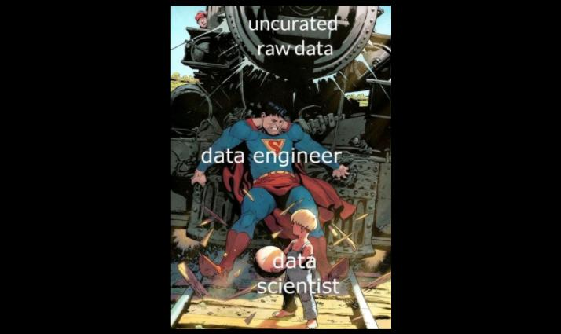

Slide 5
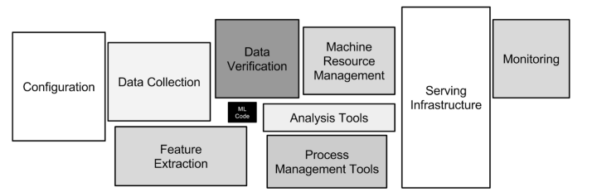
Bringing ML/AI Models into Production: Why Fail?
Machine learning projects are much more than models and algorithms (much more complex).
Source: Hidden Technical Debt in Machine Learning Systems
https://proceedings.neurips.cc/paper/2015/file/86df7dcfd896fcaf2674f757a2463eba-Paper.pdf from Google research
This paper highlights the challenges of real-world machine learning systems and triggers the MLOps movement.
Notes:
In software development, technical debt is the implied cost of additional rework caused by choosing an easy solution now instead of using a better approach that would take longer. Analogous with monetary debt, if technical debt is not repaid, it can accumulate "interest", making it harder to implement changes.
Technical debt (also known as tech debt or code debt) describes what results when development teams take actions to expedite the delivery of a piece of functionality or a project which later needs to be refactored

Slide 6
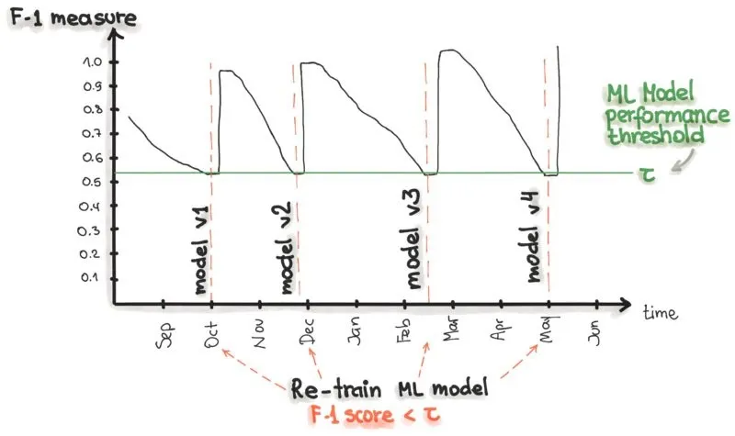
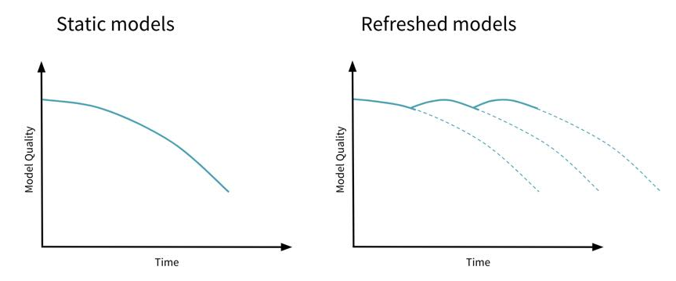
Bringing ML/AI Models into Production: Why Fail?
After deploying the model into production, the model starts to decay and to behave abnormally.
Source: https://neptune.ai/blog/retraining-model-during-deployment-continuous-training-continuous-testing
Source: https://www.oreilly.com/radar/lessons-learned-turning-machine-learning-models-into-real-products-and-services/
Source: https://www.databricks.com/blog/2019/09/18/productionizing-machine-learning-from-deployment-to-drift-detection.html

Slide 7

Bringing ML/AI Models into Production: Solution?
Fast, Reliable, Automated, Continuous
Model Development
(Development Environment)
Enable!
Model Deployment
(Production Environment)
Practices and Methodologies
Technologies and Tools
Teams with Relevant Skills
MLOps

Slide 8
MLOps Definition(s)
MLOps or ML Ops is a set of practices that aims to deploy and maintain machine learning models in production reliably and efficiently. Source: Wikipedia
The extension of the DevOps methodology to include Machine Learning and Data Science assets as first-class citizens within the DevOps ecology. Source: MLOps SIG
MLOps is a set of standardized processes and technology capabilities for building, deploying, and operationalizing ML systems rapidly and reliably. Source: Google Inc.
An optimal MLOps experience [as] one where Machine Learning assets are treated consistently with all other software assets within a CI/CD environment. Machine Learning models can be deployed alongside the services that wrap them and the services that consume them as part of a unified release process. Source: MLOps SIG
Continuous Delivery for Machine Learning (CD4ML) is a software engineering approach in which a cross-functional team produces machine learning applications based on code, data, and models in small and safe increments that can be reproduced and reliably released at any time, in short adaptation cycles. Source: Thoughtworks

Slide 9
Notebooks vs Automated ML Pipelines
ML training process takes data and code as input and produces a trained ML model as the output.
We can use Notebooks to implement a training process.
Easy to write ML code, experiment, and visualize the results
However, to automate the execution of a training process and to use complex computing environments (e.g., Kubernetes cluster, HPC cluster, or VM cluster), we need to implement the training process as an independently executable workflow.
There are ML pipeline/workflow engines that can execute ML pipelines/workflows.
e.g., AWS SageMaker, Vetext AI, Kubeflow, Dagster, ZenML , Prefect, Netflix Genie
We can trigger ML pipelines on demand, on a schedule, or in response to specified events (i.e., continuous training).
Fortunately, we can combine Notebooks and executable ML pipelines (e.g., with Vertex AI)
Use a notebook environment to develop executable ML pipelines.
Common Problems with Creating Machine Learning Pipelines from Existing Code
https://storage.googleapis.com/pub-tools-public-publication-data/pdf/b50bc83882bbd29c50250d1e59fbc3afda3fb5e5.pdf

Slide 10
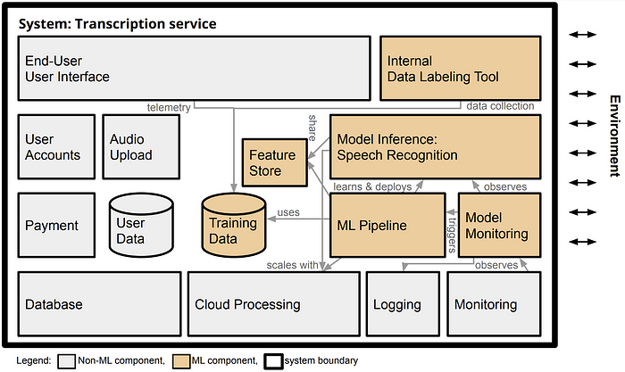
ML Models vs ML-enabled systems
ML-enabled systems consist of ML components and non-ML components.
The models do not operate in silos; they are components of, and support, a large range of application systems, such as business intelligence systems, line of business applications, process control systems, and embedded systems. [Google]
In production systems, machine learning is almost always used as a component in a larger system. [1]
[1] Architectural Components in ML-Enabled Systems https://ckaestne.medium.com/architectural-components-in-ml-enabled-systems-78cf76b29a92
Notes:
https://ieeexplore.ieee.org/document/8327042
In the transcription service startup from the previous chapter, machine learning provides the very core functionality of the system that converts uploaded audio files into text. Yet, to turn the model into a product, many other (usually non-ML) parts are needed, such as (a) a user interface to create user accounts, upload audio files, and show results, (b) a data storage and processing infrastructure to queue and store transcriptions and process them at scale, (c) a payment service, and (d) monitoring infrastructure to ensure the system is operating within expected parameters.

Slide 11
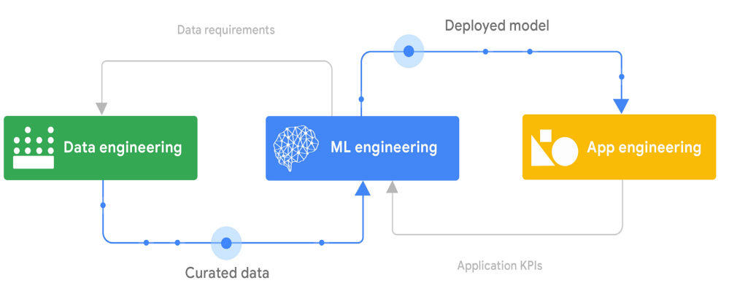
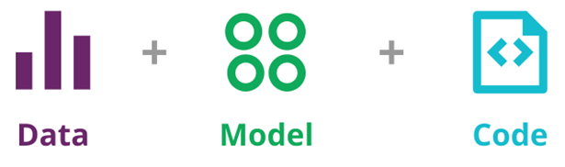
ML Models vs ML-enabled systems (Cont’d)
Changes (e.g., a new feature and bugfix) can happen at data, model, and code levels.
Building an ML-enabled system is a multifaceted undertaking that combines data engineering, ML engineering, and application engineering tasks (a cross-functional team).
Source: Practitioners guide to MLOps: A framework for continuous delivery and automation of machine learning. Google
Source: https://martinfowler.com/articles/cd4ml.html

Slide 12
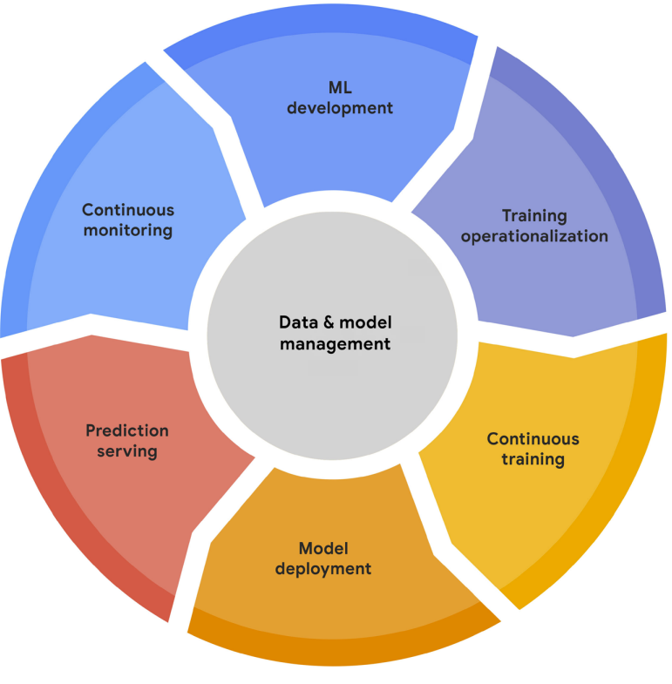
MLOps Lifecycle
ML development – build executable, reproducible training pipelines
Training operationalization – CI-CD pipelines for packaging, testing, and deploying pipelines
Continuous training – automated execution of pipelines in response to various triggers
Model deployment – CI-CD pipelines for packaging, testing, and deploying the serving app
Prediction serving – provide the inferences from the model in production (via the serving app)
Continuous monitoring – monitor model performance and data quality
Data and model management – store, manage, and govern raw data, features, models, and other ML artifacts.
Source: Practitioners guide to MLOps: A framework for continuous delivery and automation of machine learning. Google
Notes:
ML development concerns experimenting and developing a robust and reproducible model training procedure (training pipeline code), which consists of multiple tasks from data preparation and transformation to model training and evaluation. • Training operationalization concerns automating the process of packaging, testing, and deploying repeatable and reliable training pipelines. • Continuous training concerns repeatedly executing the training pipeline in response to new data or to code changes, or on a schedule, potentially with new training settings. • Model deployment concerns packaging, testing, and deploying a model to a serving environment for online experimentation and production serving.

Slide 13
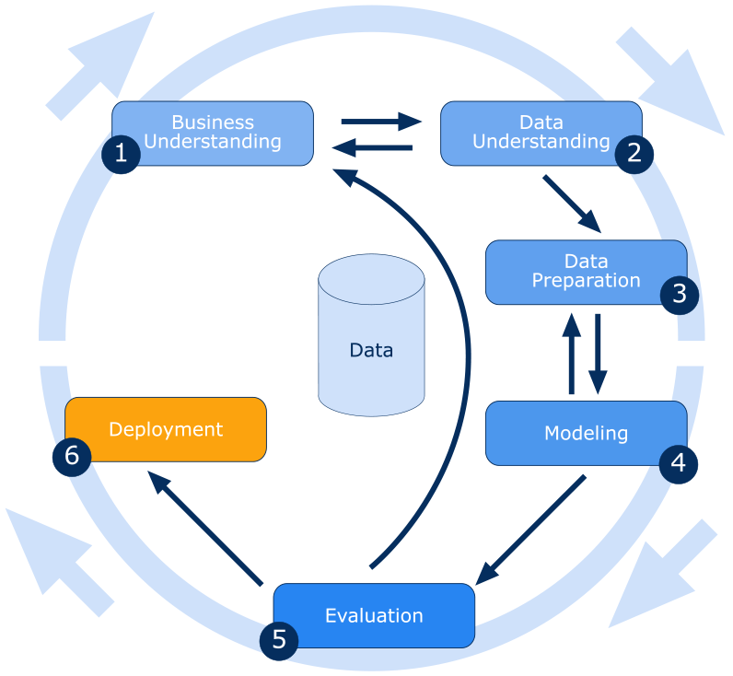
Which is a tailoring of CRISP-DM ☺

Slide 14
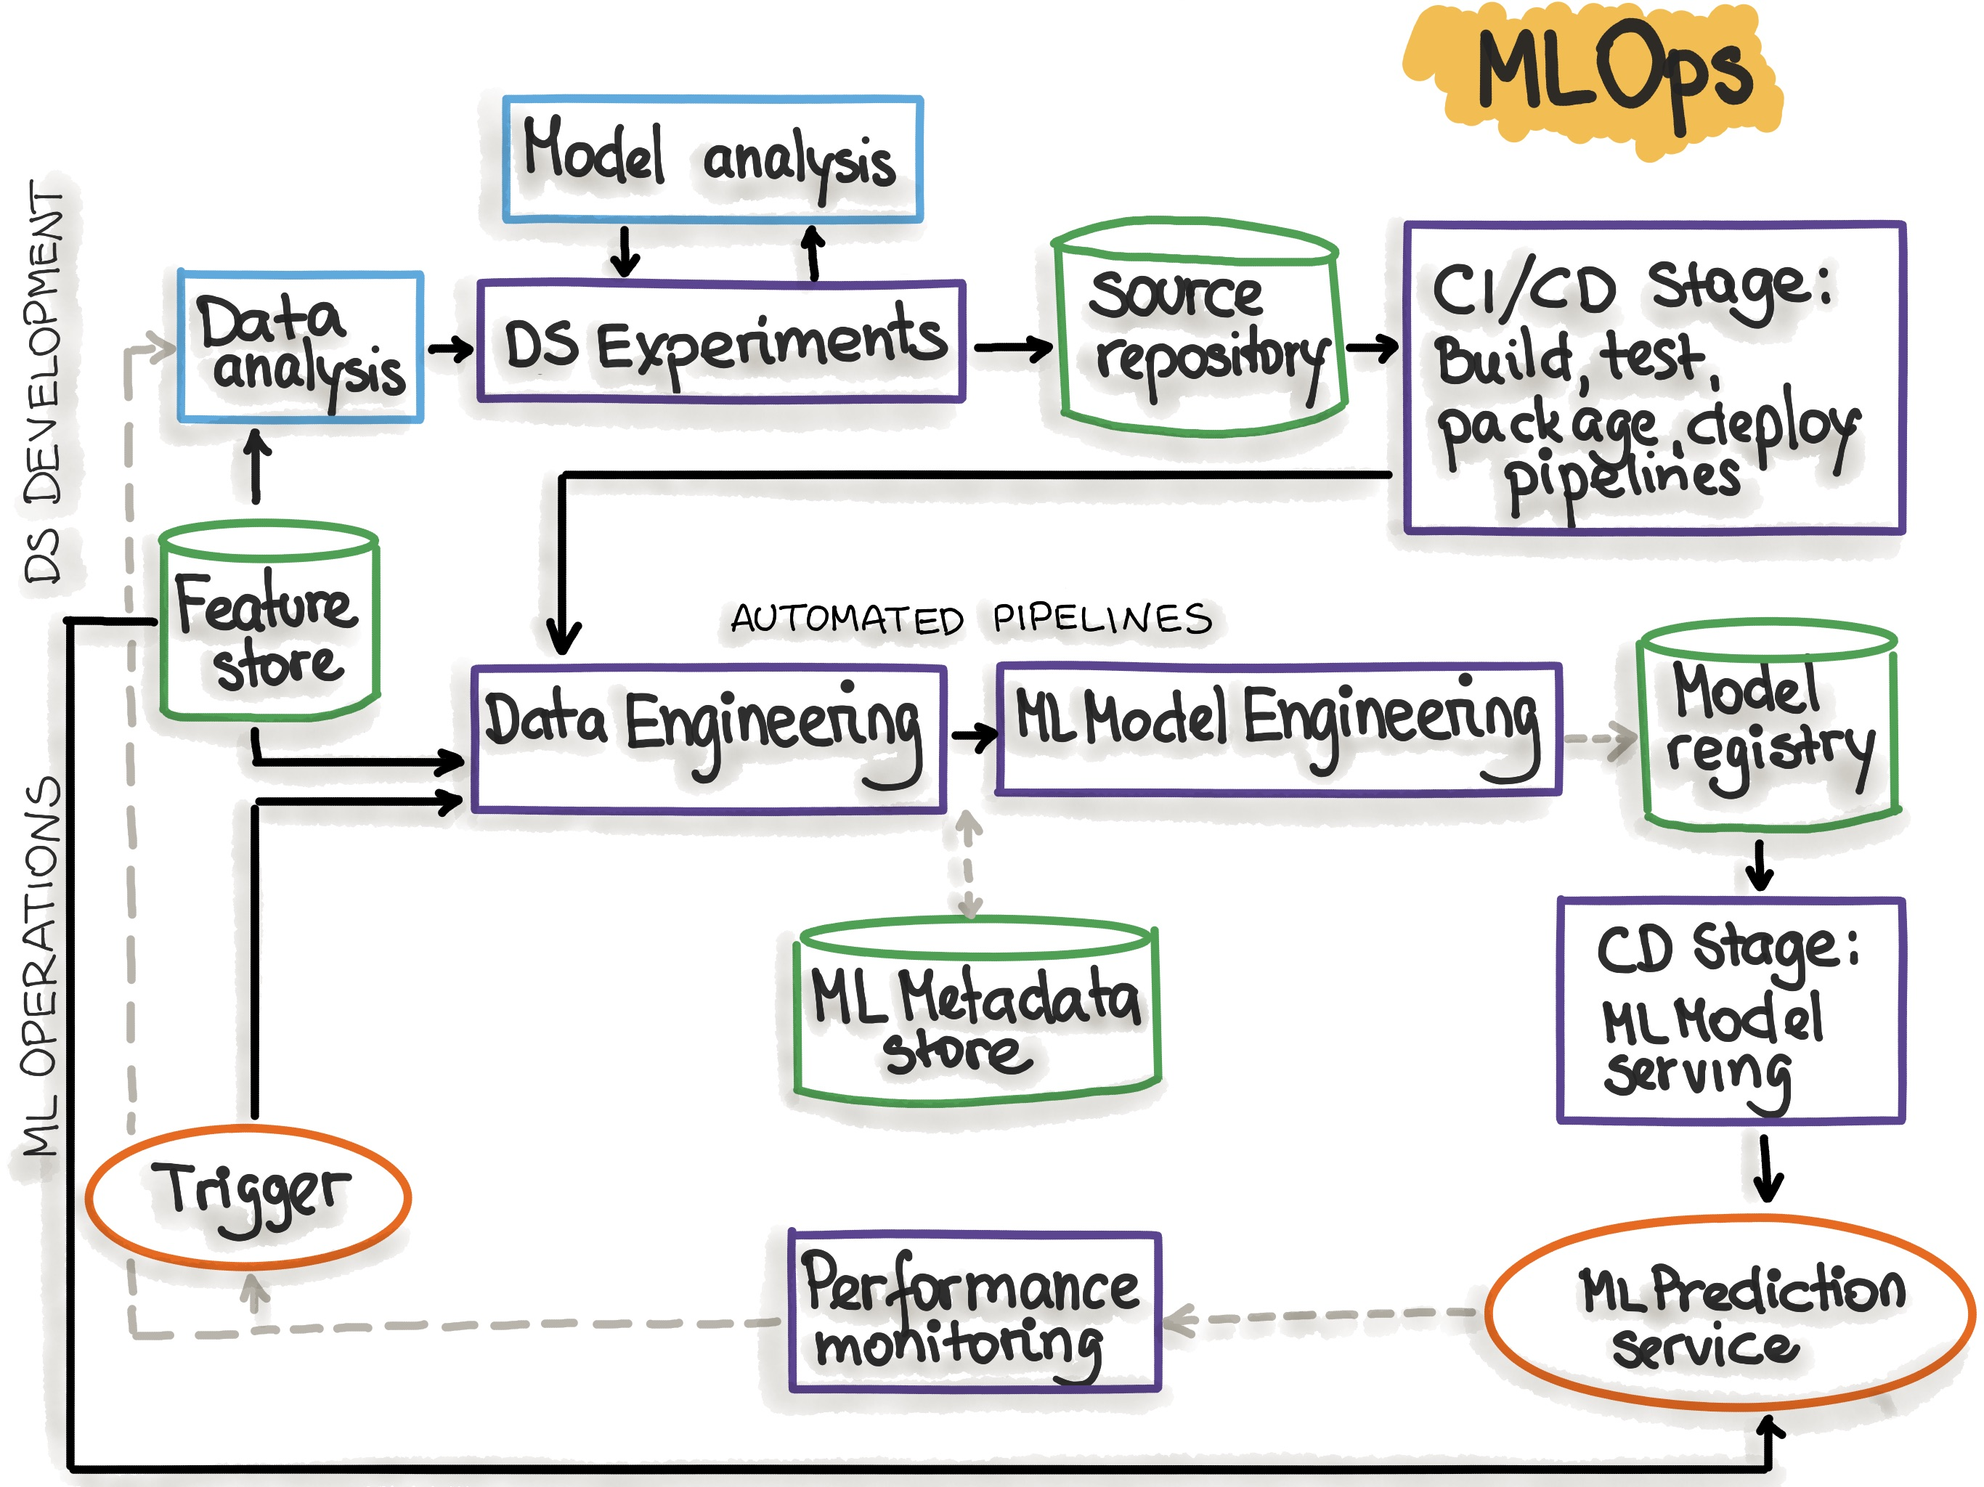
An MLOps Architecture Blueprint (Simplified)
Can you map the MLOps Life stages to the architecture components in this blueprint?
ML development
Training operationalization
Continuous training
Model deployment
Prediction serving
Continuous monitoring
Data and model management
CI also is relevant hee
source: https://ml-ops.org/content/mlops-principles
DS – Data Science

Slide 16
Model Development and Evolution
Why do we need to store executable ML pipelines?
Problem Definition
Experiment Notebooks and
Executable Training Pipelines
Model Validation
Data Selection
Raw data store
Model Prototyping
Data Exploration
Version Control System
What metadata should be recoded?
Why do we need to record experiment metadata (experiment tracking)?
Feature store
Feature Engineering
Models
Metadata and artifacts of the
experiments
Model Registry
ML Metadata and Artifact Store
Source: Practitioners guide to MLOps: A framework for continuous delivery and automation of machine learning. Google
Notes:
The CRoss Industry Standard Process for Data Mining (CRISP-DM)

Slide 17
Model Development and Evolution (Cont’d)
Experiment tracking saves all experiment-related information in a database and allows query and interactive exploration of the information.
Why do we need experiment tracking?
Reproduce, re-run, share, reuse, and compare experiments
Debug model training and auditing models
What should we record?
Training Parameters
Hyperparameters, model architectures, training algorithms, train-validation-test splits
Model Metrics
Training and evaluation accuracy, loss
Other Metadata
Training source code location (e.g., the revision number and the GitHub URL), data versions, experiment names, training Job parameters (CPU, GPU and instance type), artifact locations (e.g., Google bucket name), etc.
Source: Practitioners guide to MLOps: A framework for continuous delivery and automation of machine learning. Google

Slide 18
Model Development and Evolution (Cont’d)
Feature Store
Store and manage features (produced by feature engineering pipelines).
It enables the reuse of features.
Various model training pipelines and prediction applications use the features from the feature store.
Model Store
Stores ML models, including their versions and metadata.
Enable easy discovery, sharing, and governance of models.
Metadata Store
Store various types of metadata (e.g., database schemas, ML pipeline parameters, data source information, evaluation metrics, etc.).
Enable easy discovery of data, reconfigurability of pipelines, governance of data/models/pipelines/etc.
Notes:
https://towardsdatascience.com/the-only-3-ml-tools-you-need-1aa750778d33

Slide 19
Model Development and Evolution (Cont’d)
Outputs form the experimentation stage can include:
Candidate models (stored in the model registry)
Implementation of the continuous training pipeline (pipeline configuration/model and source code, stored in a versioned control system)
If we need to retrain ML models on a regular basis, we need the pipelines that can produce models.

Slide 20
(Re-)Training Operationalization
CI-CD Trigger
CD
Production Deployment
CI
Deploy to Staging
Production
Code and Config
Build
Smoke Tests
Acceptance Testing
Pipelines
Integration Testing
Staging
Release
Version Control
System
Deploy to Production
ML Pipeline Engines
What are the common CI-CD triggers?
Pipeline Components
(e.g., Docker Images)
Artifact Store
Source: Practitioners guide to MLOps: A framework for continuous delivery and automation of machine learning. Google
Notes:
In the CI stage, the source code is unit-tested, and the training pipeline is built and integration-tested. Any artifacts that arecreated by the build are stored in an artifact repository.
In the CD stage, the tested training pipeline artifacts are deployed to a target environment, where the pipeline goes through end-to-end testing before being released to the production environment. Typically, pipelines are tested in non-production environments on a subset of production data, while the full-scale training is performed only in production environments.
The newly deployed training pipeline is smoke-tested. If the new pipeline fails to produce a deployable model, the model serving system can fall back to the model that was produced by the current training pipeline.

Slide 21
Automated (Continuous) Training
What are the common Re-training triggers?
Re-training Trigger
Metadata Store
Artifact Store
Continuous Training Pipeline
Data Loading and Processing
Model Validation
Model Evaluation
Models
Raw Data Store
Feature Engineering
Model Training
Model Registration
Model Registry
Feature Store
Data Processing Engine
ML Training Engine
Model Evaluation Engine
Source: Practitioners guide to MLOps: A framework for continuous delivery and automation of machine learning. Google
Notes:
The continuous training process is about orchestrating and automating the execution of training pipelines.

Slide 22
Automated (Continuous) Training (Cont’d)
Trigger Types
On demand: Ad-hoc the manual execution of the pipeline.
Scheduled
The models are retrained periodically, according to a schedule (e.g., daily, weekly, or monthly).
Event-driven
An event indicates a change in the MLOps environment. e.g., updating the source code in the GitHub repository and adding a new feature set to the feature store.
Metric-based
Some metrics are monitored and used to determine if re-retraining is necessary. e.g., model performance metrics and data quality metrics.

Slide 23
Automated (Continuous) Training (Cont’d)
Trigger Types
On demand: Ad-hoc the manual execution of the pipeline.
Scheduled
The models are retrained periodically, according to a schedule (e.g., daily, weekly, or monthly).
Event-driven
An event indicates a change in the MLOps environment. e.g., updating the source code in the GitHub repository and adding a new feature set to the feature store.
Metric-based
Some metrics are monitored and used to determine if re-retraining is necessary. e.g., model performance metrics and data quality metrics.
66%
24%
<4%
~6%
Can we combine Metric-based and Event-driven?

Slide 24
Automated (Continuous) Training (Cont’d)
Assign the best retraining strategy for the following use cases:
A student attrition model that predicts whether a student will return the following semester. The predictions are made on the current cohort of students directly after midterms.
A stock price predictor model that continuously predict the future value of a stock traded on a stock exchange for getting profits.
The new (automated) ethical standard tests for a facial recognition model detected the use of sensitive personal data without anonymizing them. A new model needs to be retrained by properly preserving data privacy.
For a sentiment prediction model, a new tweets dataset is collected and made available in the source databases.
Schedule
Metrics
Event/Manual
Event
Notes:
https://mlinproduction.com/model-retraining/
https://learn.microsoft.com/en-us/azure/architecture/example-scenario/ai/student-attrition-prediction

Slide 25
Model Deployment
Artifact Registry
Version Control
System
Re-deployment Trigger
Serving App Code
Test
Build Serving App Image
Register Image
Deploy Model Serving App Image
Model Deployment CI-CD Pipeline
Model Registry
What are the common re-deployment triggers?
What are things we need to consider before starting the deployment?
Source: Practitioners guide to MLOps: A framework for continuous delivery and automation of machine learning. Google and
https://cloud.redhat.com/blog/enterprise-mlops-reference-design
Notes:
When deploying systems you need to check certain items and how robust is your deployment strategy to deal with these items:
Is there already an existing model in production that will be replaced?
If there is a bug in the new deployment, Is there a quick and applicable rollback plan?
if my model doesn’t reach the required accuracy in production , how huge is the negative consequences , and what is the best strategy to minimize them?
How Fast will the new model be rolled out?

Slide 26
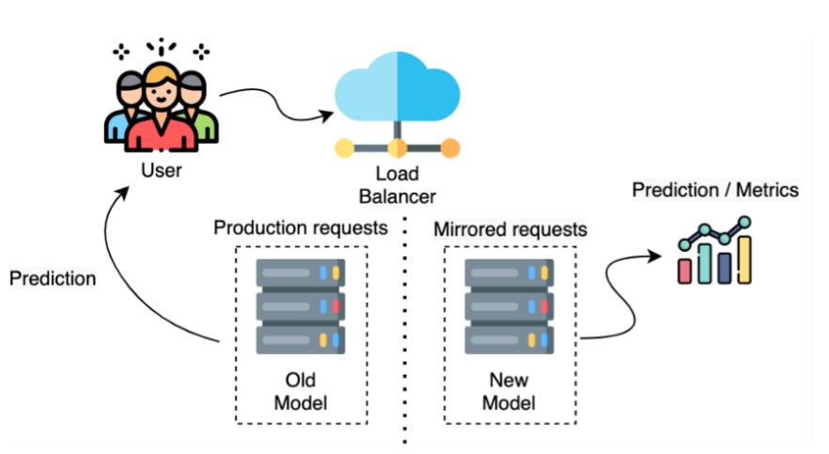
Model Deployment : Deployment Strategies
The new model (called the shadow model) is deployed alongside the old live model.
Duplicate the requests and send all production traffic to both models
However, the predictions from the new model are not used to service end-users.
Predictions from the new model are used to compare it with the old model.
If the new model is good enough to replace the old one, we can redirect user traffic to the new model (or use both models in parallel)
Shadow Deployment
source: https://www.linkedin.com/pulse/ml-models-deployment-strategies-kholoud-ibrahim-/?trk=articles_directory
Notes:
This strategy may use two identical environments - the old model in the original production environment and the new model in the shadow environment.

Slide 27
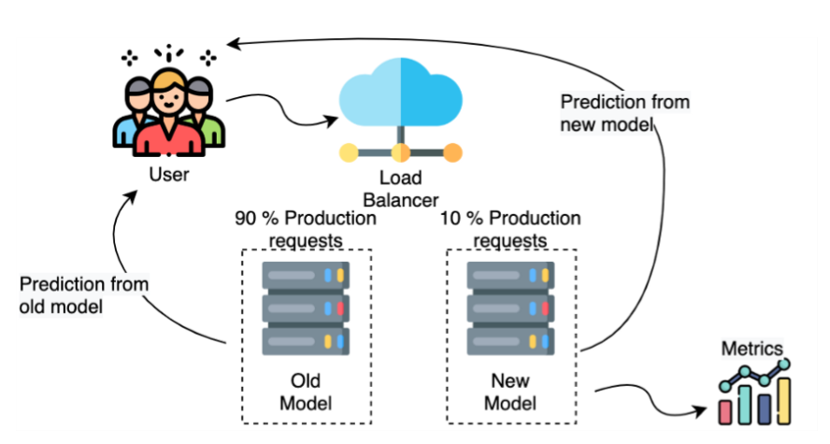
Model Deployment : Deployment Strategies (Cont’d)
Canary Deployment
Two models run in parallel
A certain user percentage is exposed to the new model.
The new model’s performance is monitored, and if the new model is good enough, its percentage of user traffic can be increased.
source: https://www.linkedin.com/pulse/ml-models-deployment-strategies-kholoud-ibrahim-/?trk=articles_directory

Slide 28
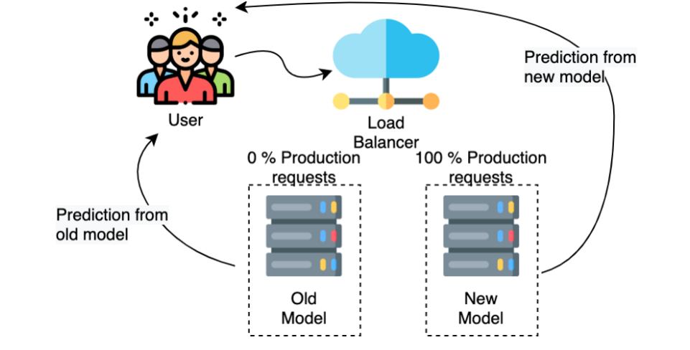
Model Deployment : Deployment Strategies (Cont’d)
Blue/Green Deployment
Two models run in parallel
Blue-green deployment strategies involve two (identical) production environments instead of just models.
Once the new model is made live, the traffic is diverted from the blue environment to the green environment completely (100%).
The blue environment can still serve as a backup.
source: https://www.linkedin.com/pulse/ml-models-deployment-strategies-kholoud-ibrahim-/?trk=articles_directory

Slide 29
Model Deployment : Deployment Strategies (Cont’d)
Criterion A: negative impacts on users due to (new) model’s failures
Lowest -
Highest -
Criterion B: How fast is the roll out of the new model
Slowest -
Fastest -
Criterion C: How fast is the rollback of the model
No rollback necessary -
Fast rollback -
Shadow
Blue/green
Shadow / Canary
Blue/green
Shadow
Canary/ Blue/Green

Slide 30
Model Serving
Feature Store
Serving Feature Lockup
Make Prediction
Serving Data
Model Consumer
Explain Prediction
Predictions and Explanations
Service Metrics and Request/Response Payloads
Serving Logs
Model Monitoring Engine
Source: Practitioners guide to MLOps: A framework for continuous delivery and automation of machine learning. Google
Notes:
The serving engine can serve predictions to consumers in the following forms:
Online inference in near real time for high-frequency singleton requests (or mini batches of requests), using interfaces like REST or gRPC.
Streaming inference in near real time, such as through an event-processing pipeline.
Offline batch inference for bulk data scoring, usually integrated with extract, transform, load (ETL) processes.
Embedded inference as part of embedded systems or edge devices.
In some scenarios of prediction serving, the serving engine might need to look up feature values that are related to the request. For example, you might have a model that predicts the propensity of a customer to buy a particular product, given a set of customer and product features. However, the request includes only the customer and the product identifier. Therefore, the serving engine uses these identifiers to fetch the customer and the product feature values from a feature repository and then to feed them to the model to produce a prediction.

Slide 31
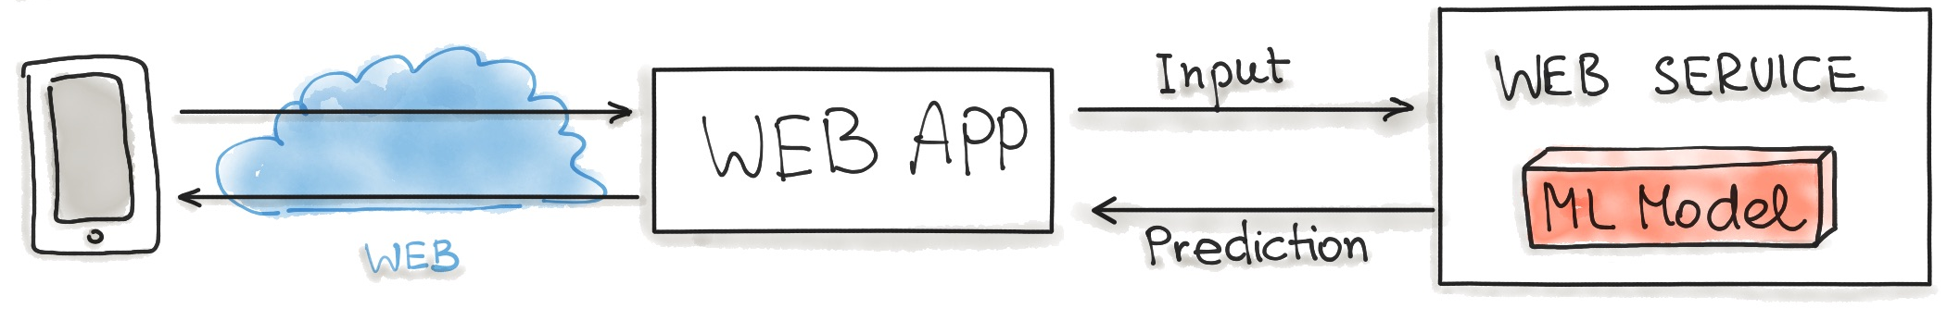
Model Serving: Design Patterns (Cont’d)
Model-as-Service/API (Online Inference)
Web Service = Web API
Can you give an example from labs?
source: https://ml-ops.org/content/three-levels-of-ml-software

Slide 32
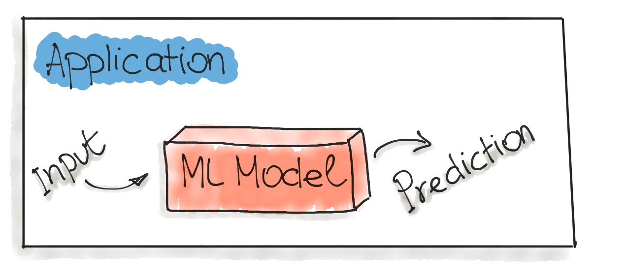
Model Serving: Design Patterns (Cont’d)
Model-as-Dependency (Online Inference)
Can you give an example from labs?
source: https://ml-ops.org/content/three-levels-of-ml-software

Slide 33
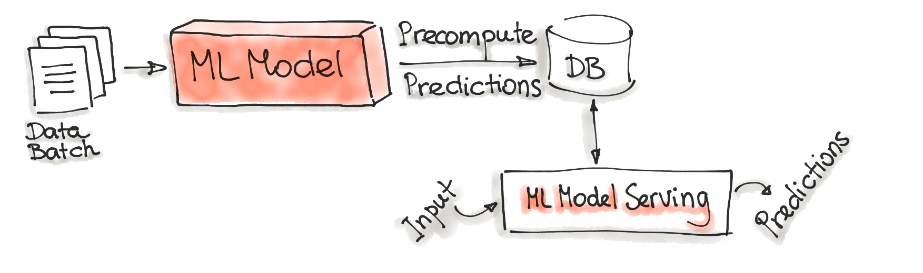
Model Serving: Design Patterns (Cont’d)
Precompute (Offline Inference)
How can we automate the precomputation of predictions?
How can the ML Model Serving component be made available to external users?
How can we apply this pattern to our Lab example?
source: https://ml-ops.org/content/three-levels-of-ml-software

Slide 34
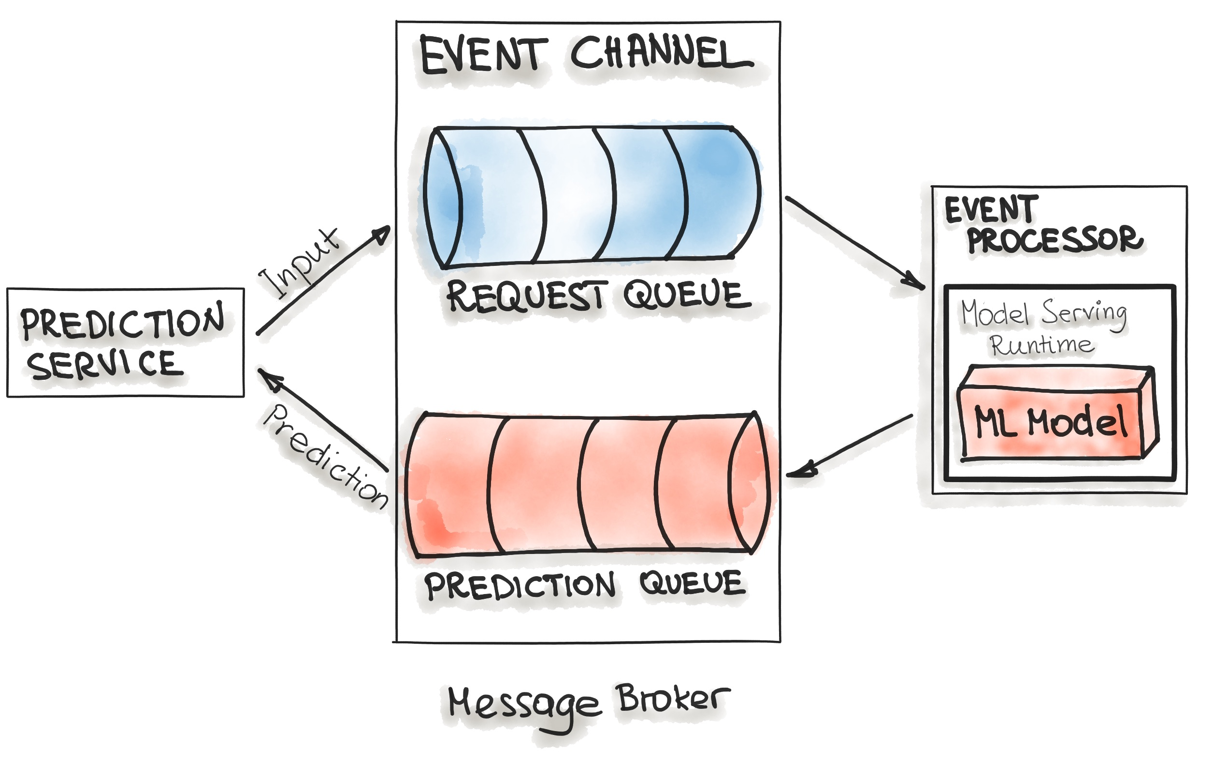
Model Serving: Design Patterns (Cont’d)
Model-On-Demand
Prediction service puts the prediction requests from the end-users at the Request Queue.
Event processor reads the requests and uses the model to make predictions.
Then, the prediction results are put in the Prediction Queue.
Prediction service can pick the prediction result messages from the queue and send them back to the end users.
source: https://ml-ops.org/content/three-levels-of-ml-software

Slide 35
Monitoring
Alerting
Triggers
Baseline stats, schemas
Data Drift Detection
ML Metadata and Artifacts Repositories
Serving Logs
Concept Drift Detection
Evaluation metrics, anomalies
Continuous Evaluation
Serving efficiency metrics
(e.g., latency, error rates, resource usage)
Labels (Ground Truth)
Data and Feature Stores
Source: Practitioners guide to MLOps: A framework for continuous delivery and automation of machine learning. Google
Notes:
A sample of the request-response payloads is captured and stored in the serving logs store.
The monitoring engine periodically loads the latest inference logs, generates a schema, and computes statistics for the serving data.
The monitoring engine compares the generated schema to a reference schema to identify schema skews, and compares the computed statistics to baseline statistics to identify distribution skews.
4. If the true labels (ground truth) for the serving data are available, the monitoring engine uses it to evaluate the model predictive effectiveness in hindsight on the serving data.
5. If anomalies are identified, or if the model’s performance is decaying, alerts can be pushed through various channels (for example, email or chat) to notify the owners to examine the model or to trigger a new retraining cycle.
In some scenarios, your system is able to store ground truth for your serving data. For example, you capture whether a customer bought a product recommended by your model, or you calculate the actual demand for a particular product by the end of the week compared to the demand that was forecasted by the model. You can use this information as true labels to your serving data, and the information can be stored and retrieved from the dataset and feature repository for continuous evaluation and for further model training cycles.
Besides monitoring model effectiveness, monitoring model serving efficiency focuses on metrics like the following:
Resource utilization, including CPUs, GPUs, and memory.
Latency, which is a key metric in online and streaming deployments to indicate model service health.
Throughput, which is a key metric in all deployments.
Error rates.
Measuring these metrics is helpful not only in maintaining and improving system performance, but also in predicting and managing costs.
28

Slide 36
Monitoring (Cont’d)
Model drift or the degradation of the model performance over time is very common. Model drift is twofold: data-drift and concept drift.
Data-drift is a variation in the production data from the data that was used to test and validate the model. Data drift can involve two types of skews:
Schema skew occurs when training data and serving data do not conform to the same schema.
Distribution skew occurs when the distribution of feature values for training data is significantly different from the distribution for serving data.
Concept drift is a changing relationship between the input predictors and the target variable.
What is the common solution to handling drifts?
Notes:
Concept Drift in machine learning is a situation where the statistical properties of the target variable (what the model is trying to predict) change over time. In other words, the meaning of the input data that the model was trained on has significantly changed over time, but that the model in production doesn’t know about the change and therefore can no longer make accurate predictions.
The data validation step can detect when data anomalies start occuring. These anomalies can include new features, new feature domains, features that have disappeared, and drastic changes in feature distributions. The data validation step works by comparing the new training data to the expected data schema and reference statistics.

Slide 37
Monitoring (Cont’d)
Assign Concept Drift, Schema skew, and Distribution skew to the following cases:
Sentiment predictor. As over time people’s sentiments about the critical topics change, tweets belonging to negative sentiment may evolve over time to be positive (and vice versa).
Weather prediction model. The model used the temperature data collected from a sensor in Celsius degrees, but the unit changed to Fahrenheit.
Wine preference prediction model. The model was built using the attributes of Netherland wines and the preference scores from native Dutch people. Now, the wines are from France, and we need to predict the preference of French people.
Covid risk predictor of the App. The model was mostly trained using the data from younger app users. Now, the data are available from a board user base, with a lot of older users. The model used the age as a feature.
Concept
Schema Skew
Both Types of above Drifts
Distribution skew

Slide 38
Model Governance
Model Governance
Store
Evaluate
Check
Release
Report
Add/update
model properties
Compare models
Review
Deploy
Aggrege and visualize performance metrics
Track
Explain models
Approve
Rollback
Model Registry
Serving
Engine
The governance process can be automated, semi-automated, or fully automated.
Metadata and Artifact Repository
Source: Practitioners guide to MLOps: A framework for continuous delivery and automation of machine learning. Google
Notes:
Model governance can use information in the ML metadata and the model registry to do the following tasks:
Store: Add or update model properties and track model versions and property changes. The model registry can store many model versions from the experimentation and continuous training phases, which lets data scientists easily reproduce significant models.
Evaluate: Compare a new challenger model to the champion model by looking not only at evaluation metrics (accuracy, precision, recall, specificity, and so on) but also at business KPIs that are collected through online experimentation. Additionally, model owners need to be able to understand and explain the model predictions—for example, by using feature attribution methods. This ensures the quality of the model that is deployed in production.
Check: Review, request changes, and approve the model to help control for risks, such as business, financial, legal, security, privacy, reputational, and ethical concerns.
Release: Invoke the model deployment process to go live. This controls the type of the model release (for example, canary or blue-green) and the traffic split that is directed to it.
Report: Aggregate, visualize, and highlight model performance metrics that are collected from the continuous evaluation process. This ensures the quality of the model in production.
An internal framework of a firm or organization that controls the processes for model development, validation and usage, assign responsibilities and roles etc.
Who has ownership of a model?
Does a model comply with relevant regulations?
What data has a model been trained on?
What validation and approval is needed at each stage of development?
How do we monitor models post-deployment?
ML metadata tracking is generally integrated with different MLOps processes. The artifacts produced by the other processes are usually automatically stored in an ML artifact repository, along with the information about the process executions. ML metadata that is captured can include pipeline run ID, trigger, process type, step, start and end datetime, status, environment configurations, and input parameter values. Examples of artifacts that are stored include processed data splits, schemas, statistics, hyperparameters, models, and evaluation metrics or custom artifacts.

Slide 39
Model Governance (Cont’d)
Store
Store model versions to enable model reproducibility, rollback plans, auditing, etc.
Evaluate
Compare models using model performance metrics and business KPIs
Explain the model predictions (feature importance and XAI)
Check
Review and approval processes.
Check if the model meets policy requirements (e.g., model accuracy > accuracy threshold or not bias toward a specific race)
Release
Decide and execute model deployment strategies and rollout/rollback plans
Report
Create various reports on model performance, etc.

Slide 40
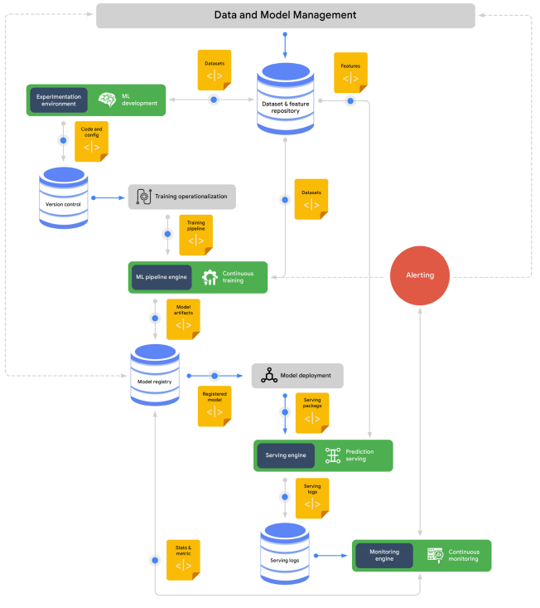

MLOps Reference Architecture : Google
https://services.google.com/fh/files/misc/practitioners_guide_to_mlops_whitepaper.pdf
Source: Practitioners guide to MLOps: A framework for continuous delivery and automation of machine learning. Google

Slide 41
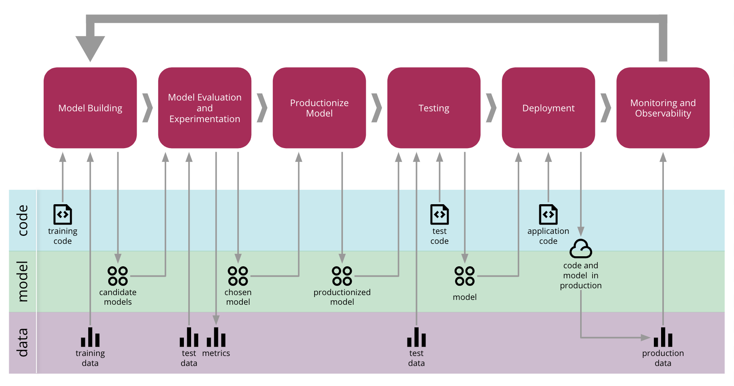
The End-to-End CD4ML Process from Thoughtworks
Source: https://martinfowler.com/articles/cd4ml.html

Slide 42
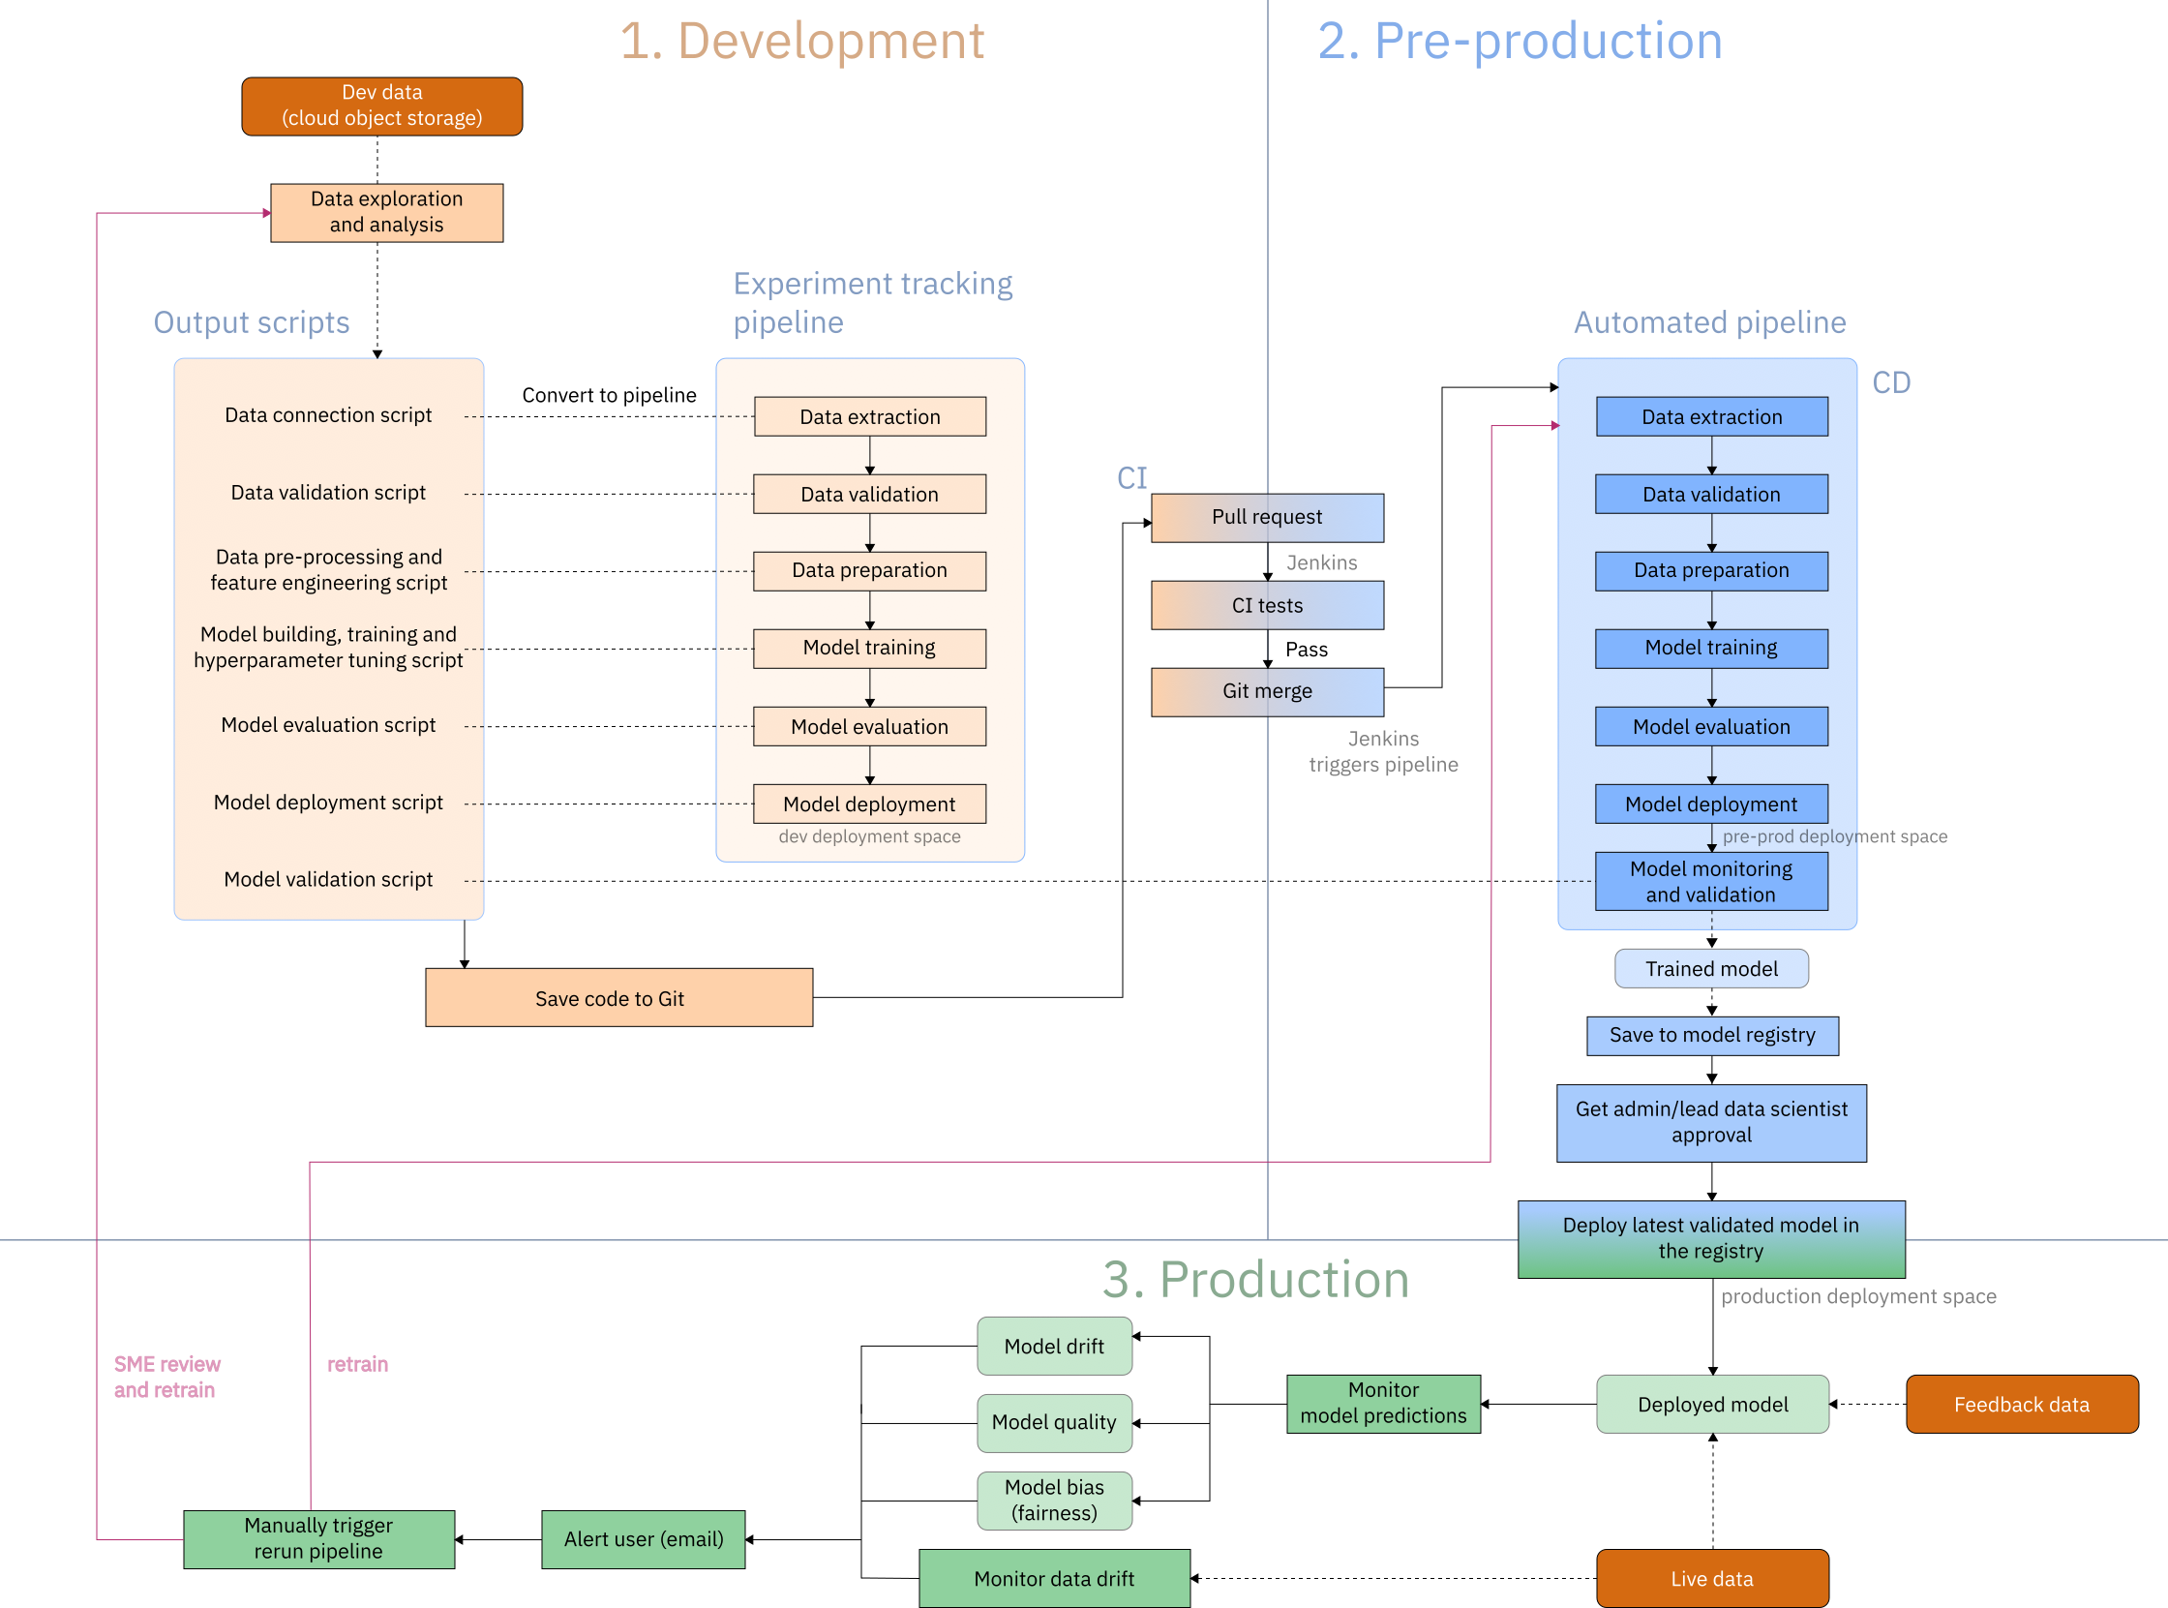
Architecture of the MLOps flow : IBM
https://github.com/IBM/MLOps-CPD

Slide 43
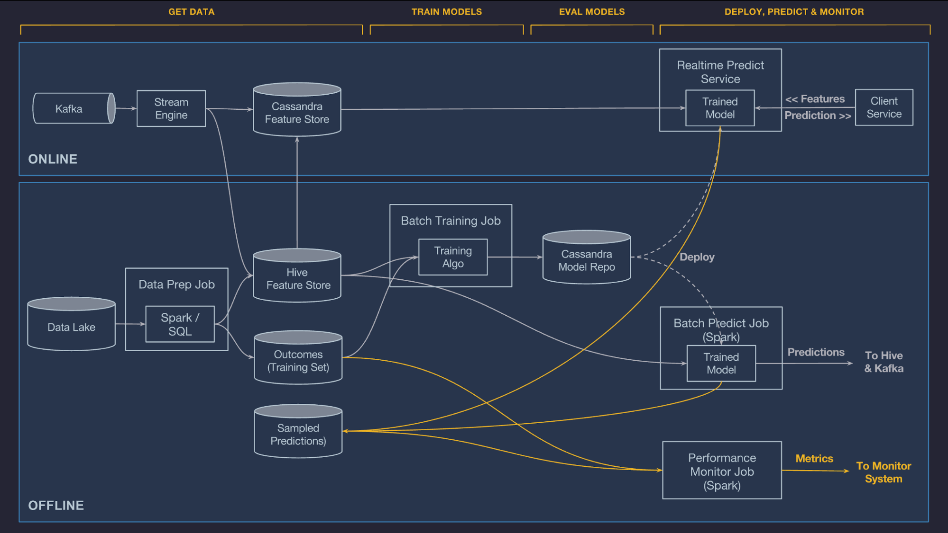
The second part of the course covers batch and stream data ingestion and processing (Kafka and Spark).
Michelangelo: Uber’s Machine Learning Platform
https://www.uber.com/en-NL/blog/michelangelo-machine-learning-platform/

Slide 44

Questions?

Slide 45
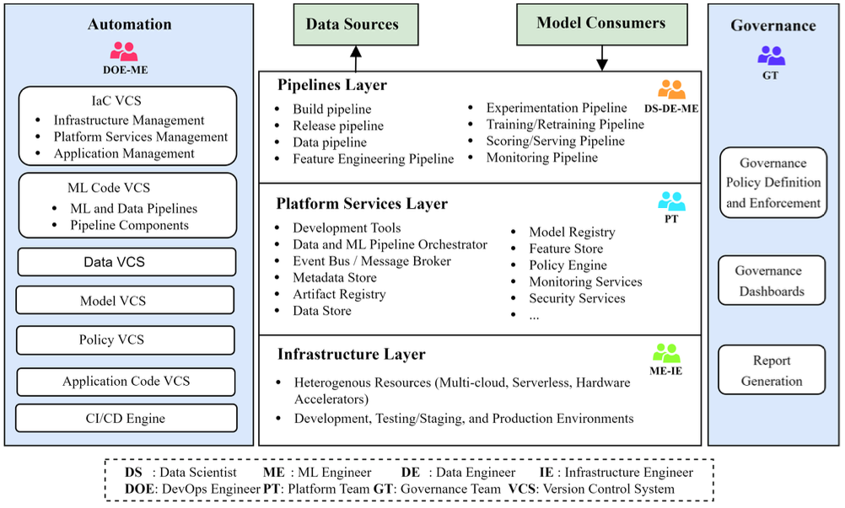
A more Academic Tale* …
*

Slide 46
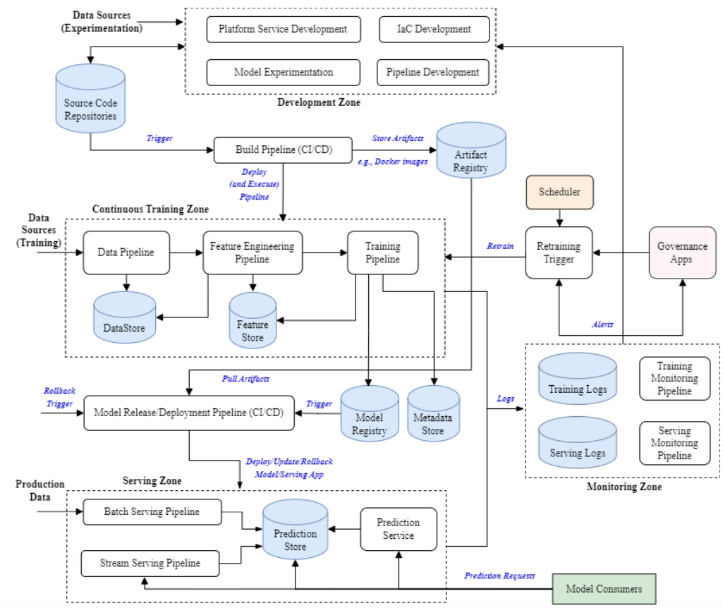

Slide 47
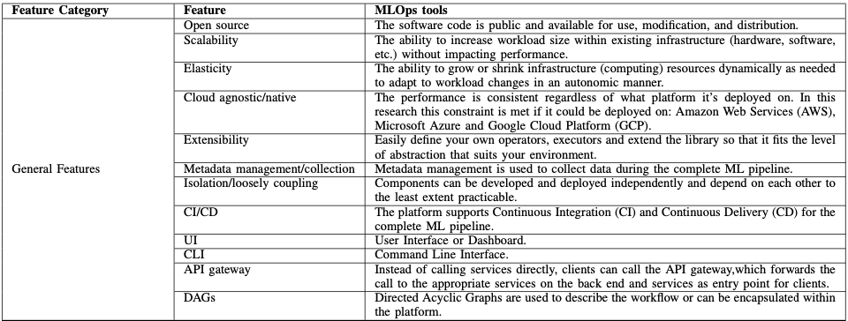
Also, Tools and features…

Slide 48
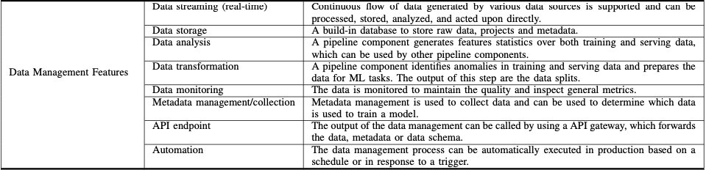
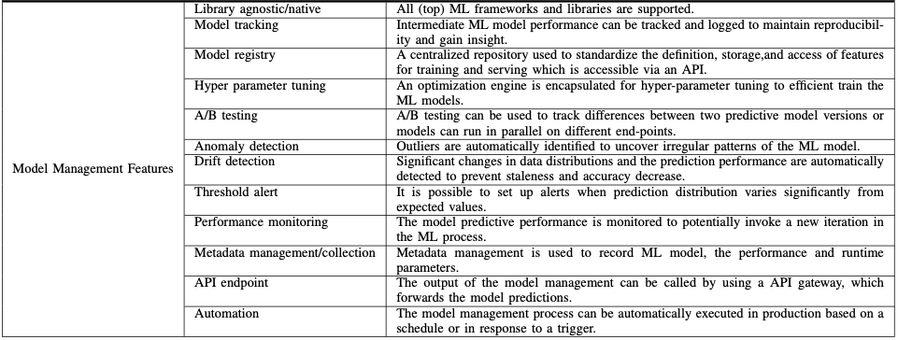
Also, Tools and features…

Slide 49

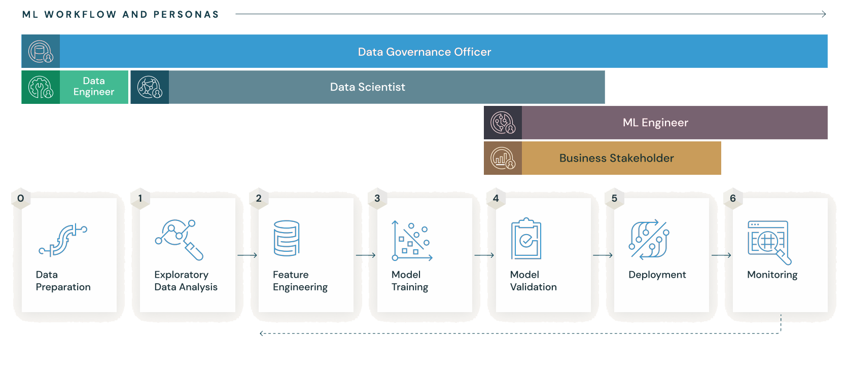
Practical Zoom:

Slide 50
Componenti principali
MLflow Tracking:
Traccia esperimenti ML: parametri, metriche, artefatti e configurazioni.
Supporta ambienti locali, distribuiti o cloud.
MLflow Projects:
Standardizza e organizza i progetti ML con un file MLproject.
Supporta la containerizzazione e la riproducibilità.
Notes:
Marco

Slide 51
Componenti principali
MLflow Models:
Gestisce il packaging e il deployment dei modelli ML in un formato standard (MLmodel).
Consente il deployment su diversi ambienti (es. servizi REST, Kubernetes, cloud).
MLflow Model Registry:
Sistema centralizzato per la gestione della versione dei modelli.
Permette di assegnare tag come "Stage" per identificare i modelli in test o produzione.
Notes:
Marco

Slide 52
Funzionalità
Tracciamento degli esperimenti: Registra automaticamente parametri, metriche e artefatti.
Confronto degli esperimenti: Confronta facilmente i risultati degli esperimenti.
Deployment dei modelli: Pacchettizzazione e distribuzione dei modelli in ambienti di produzione.
Notes:
Marco

Slide 53


Installazione
Compatibile con versioni di Python 3.10 o precedenti
Installazione con:
ambiente virtuale Python
ambiente conda
Notes:
Marco

Slide 54
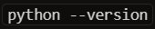
Installazione - VENV
Controllo della versione
Se la versione è diversa dalla 3.10, scaricarla dal sito: python.org
Creare un virtual enviroment
Attivarlo con per Windows
per MacOs
Installare MLflow
Notes:
Marco

Slide 55
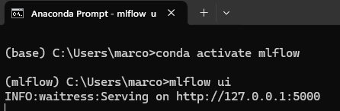
Installazione - Anaconda
Download Anaconda https://www.anaconda.com/download
Installazione dell’ambiente conda
Attivazione dell’ambiente in windows
In MacOs
Installazione di MLflow
Notes:
Marco

Slide 56
Creazione ambiente conda
Aprire terminale Anaconda
Digitare: conda create -n nome_ambiente python=3.10
Sostituisci nome_ambiente con il nome che vuoi dare al tuo ambiente e 3.8 con la versione di Python preferita.
Attiva l'ambiente con il comando: conda activate nome_ambiente
Notes:
Marco

Slide 57
Creazione ambiente conda
Installare Jupyter notebook:pip install jupyter
Intallare MLFlow :pip install mlflow
Notes:
Marco

Slide 58
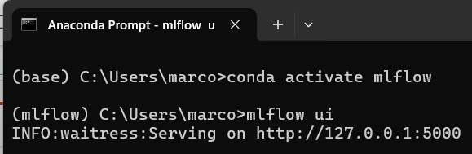
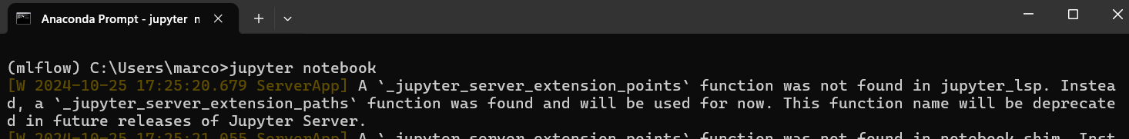
Creazione ambiente conda
Avviare Jupyter con: jupyter notebook (sarà in localhost sulla porta d'ascolto 8888)
In un'altra istanza della shell di Anaconda avviare mlflow con: mlflow ui (sarà in localhost sulla porta d'ascolto 5000)
Notes:
Marco

Slide 59
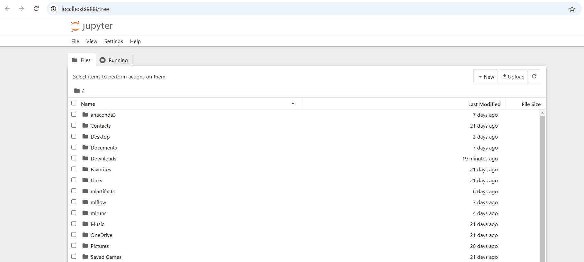
Ambiente Base: Jupyter Notebook
Notes:
Marco

Slide 60
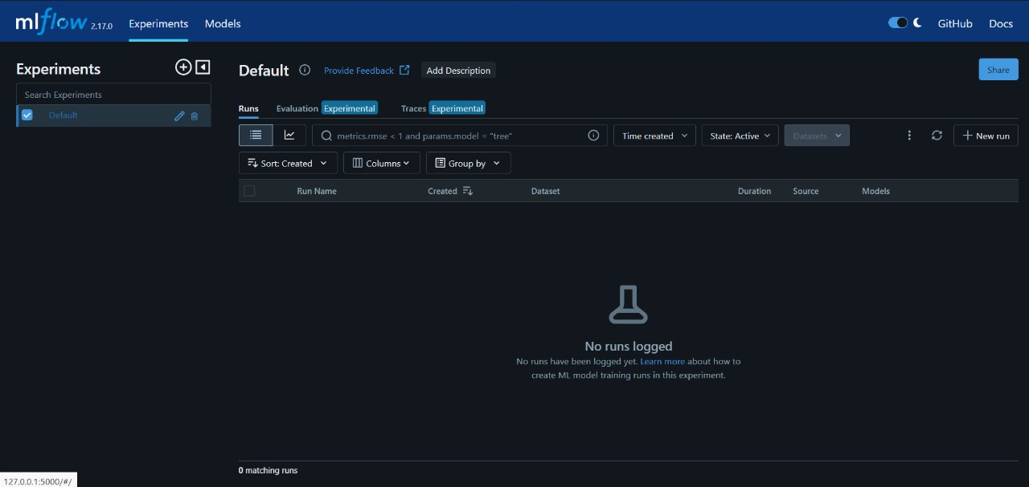
MLflow ui
Nell’ambiente attivato dove è correttamente installato MLflow, lanciare il comando mlflow ui oppure nel caso di una docker image del toll, è direttamente in localhost sulla porta d'ascolto 5000
Notes:
Marco

Slide 61
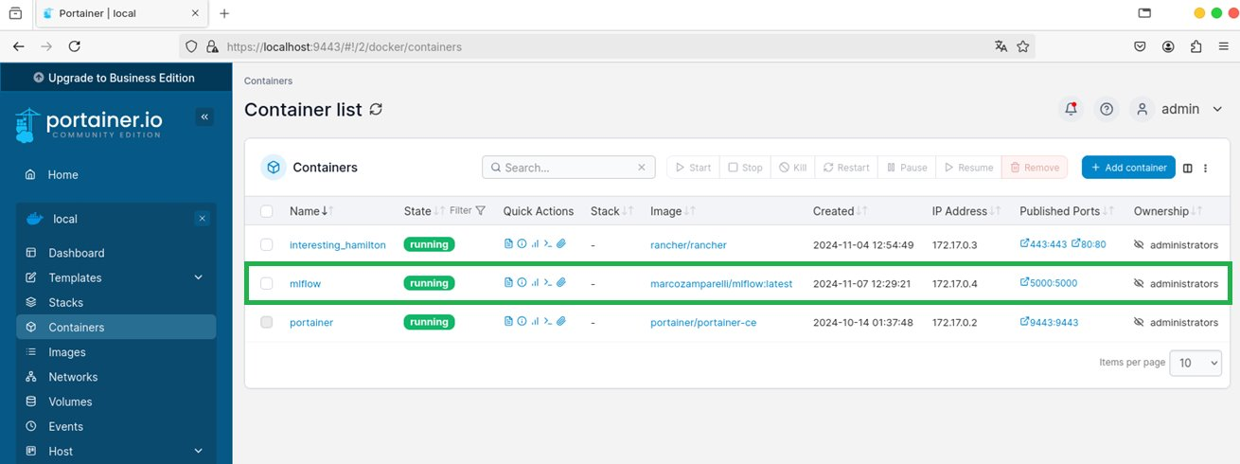
Containerization: Docker Image
Notes:
Marco

Slide 62
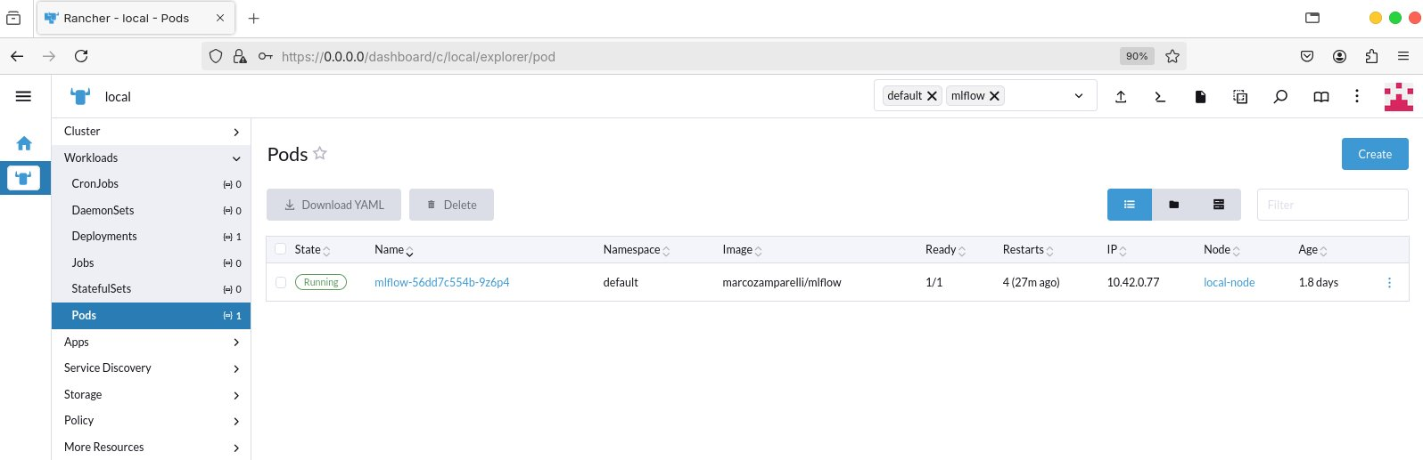
Alternative: Deployment e servicing in Kubernetes
Notes:
Marco

Slide 63


Experimentation
Le pipeline in MLflow si concretizzano negli esperimenti eseguibili tramite script python o recipe
Eseguiremo esperimenti che vanno dalla creazione di un modello alla messa in produzione di un modello qualificato.
Notes:
Christian

Slide 64

Case-Study: Wine Quality Prediction
Addestreremo una rete che sarà in grado di valutare la qualità del vino
Notes:
Christian

Slide 65
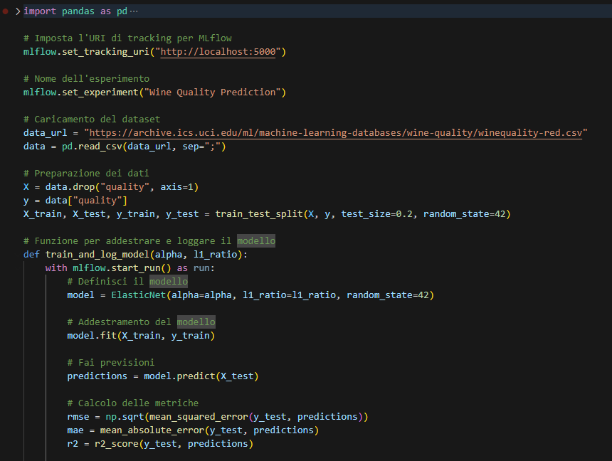
Wine Quality Prediction
Configurazione del tracciamento MLflow: Lo script imposta l'URL di tracciamento per MLflow e definisce un esperimento chiamato "Wine Quality Prediction".
Caricamento e preparazione del dataset: Utilizza il dataset del vino dalla UCI Machine Learning Repository, estraendo il target 'quality' e suddividendo i dati in set di addestramento e test.
Definizione della funzione di addestramento e logging: La funzione train_and_log_model è responsabile dell'addestramento del modello ElasticNet e del logging dei parametri e delle metriche con MLflow.
Addestramento del modello ElasticNet: Il modello viene addestrato con parametri configurabili (alpha e l1_ratio), utilizzando il set di addestramento.
Calcolo e logging delle metriche: Le metriche di valutazione, come RMSE, MAE e R², vengono calcolate e registrate per monitorare le prestazioni del modello.
Notes:
Christian

Slide 66
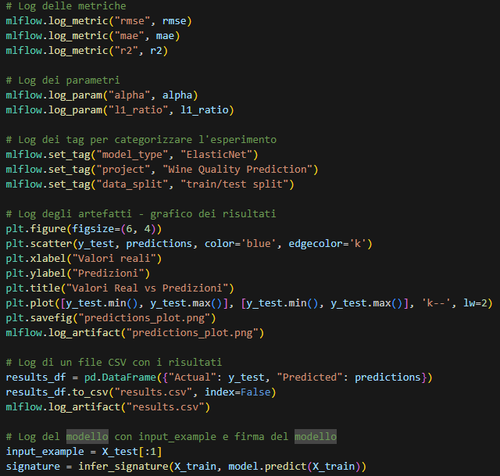
Wine Quality Prediction
Logging delle metriche e parametri: Lo script utilizza mlflow.log_metric per registrare le metriche di errore (RMSE, MAE e R²) e mlflow.log_param per tracciare i parametri del modello (alpha e l1_ratio).
Aggiunta di tag per l'esperimento: Sono definiti dei tag per categorizzare l'esperimento, specificando il tipo di modello, il progetto, e la suddivisione dei dati, facilitando la ricerca e l'organizzazione degli esperimenti.
Logging degli artefatti visivi: Viene generato un grafico che confronta i valori reali con le previsioni del modello e salvato come PNG. Questo grafico viene poi loggato come artefatto per l'analisi visiva dei risultati.
Salvataggio dei risultati come CSV: I risultati delle previsioni vengono salvati in un file CSV, che viene registrato come artefatto in MLflow, rendendo disponibili i dati per ulteriori analisi.
Logging del modello e della firma: L'esempio di input e la firma del modello vengono inferiti e loggati utilizzando mlflow.sklearn.log_model, assicurando che il modello possa essere riprodotto con lo stesso input per la produzione.
Notes:
Christian

Slide 67
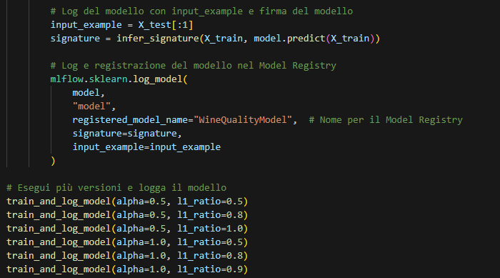
Wine Quality Prediction
Firma del modello e esempio di input: Viene generata una firma del modello utilizzando infer_signature e viene preparato un esempio di input per garantire che il modello possa essere riutilizzato correttamente in ambienti di produzione con input coerenti.
Registrazione del modello con MLflow: Il modello addestrato viene registrato nel Model Registry di MLflow con il nome "WineQualityModel". Questo include il logging della firma e dell'esempio di input per una gestione accurata del modello.
Esecuzione di più versioni del modello: Lo script esegue più versioni del modello con diverse combinazioni di alpha e l1_ratio, registrando ogni esperimento separatamente per analizzare le prestazioni e confrontare le configurazioni dei parametri.
Notes:
Christian

Slide 68
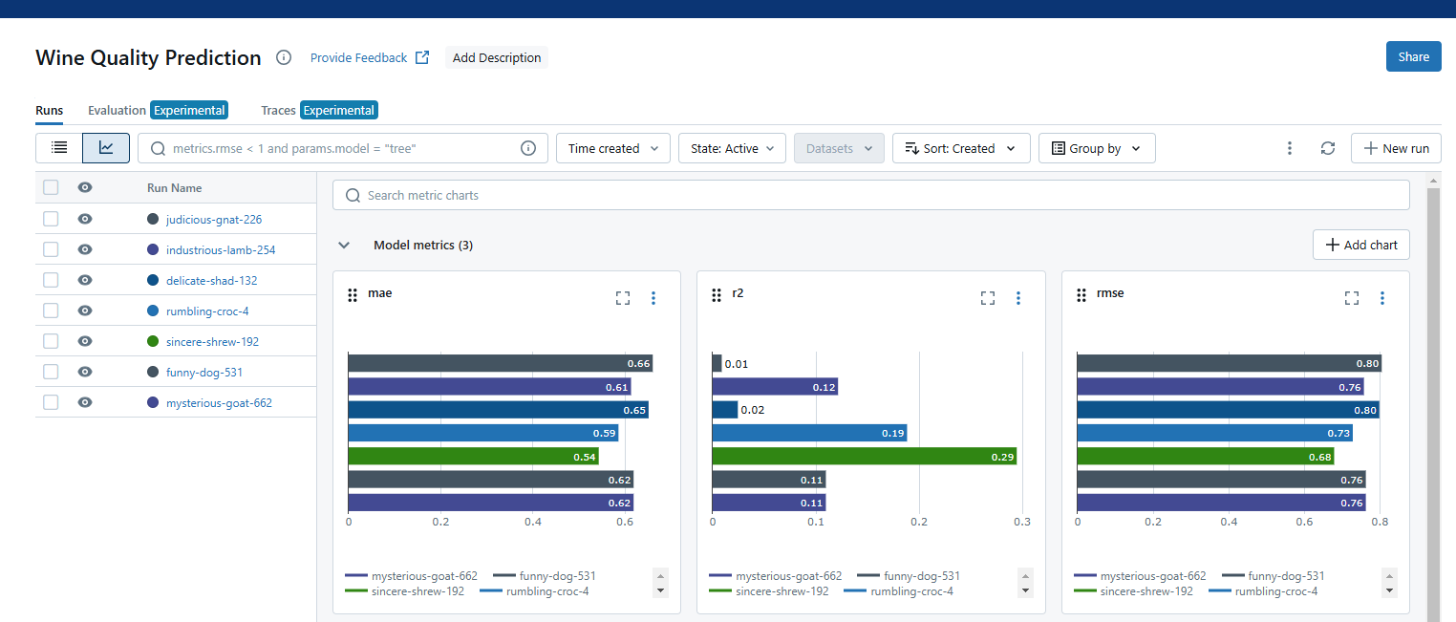
Wine Quality Prediction
Notes:
Christian

Slide 69
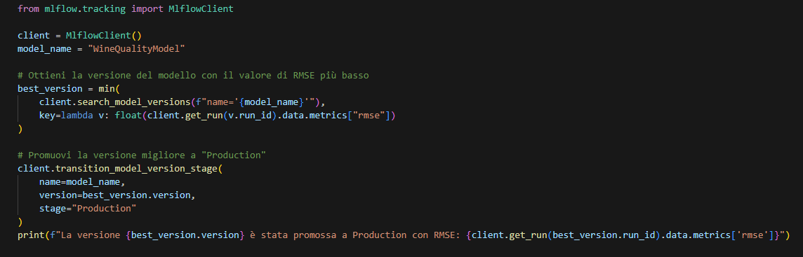
Wine Quality Prediction
Selezione e promozione automatica della migliore versione del modello: Lo script utilizza MlflowClient per cercare tutte le versioni del modello registrato, selezionando automaticamente quella con il valore di RMSE più basso e promuovendola allo stage "Production", facilitando il deployment del modello più performante.
Notes:
Christian

Slide 70
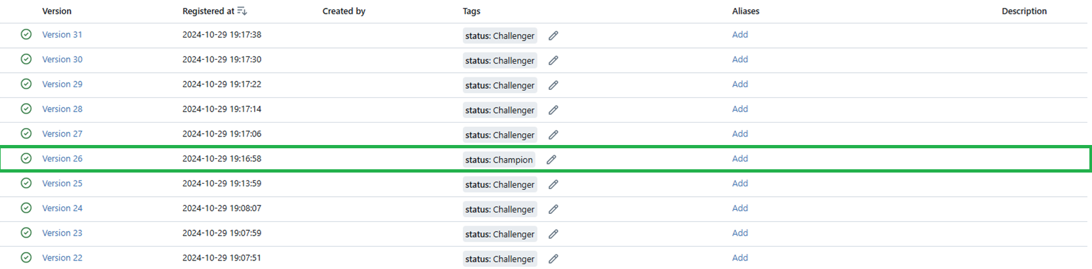
Promozione del modello a Production
L'interfaccia di MLflow Model Registry mostra diverse versioni del modello "WineQualityModel"; la Versione 26 con lo stato "Champion" è promossa a "Production".
Notes:
Christian

Slide 71

Recipe
Una recipe di Mlflow che affronta lo stesso esempio di classificazione.
Recipes, steps, esecuzione.
Notes:
Christian

Slide 72
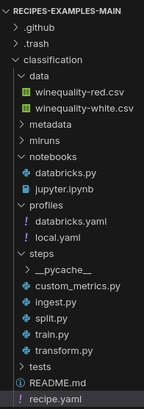
Recipes
Steps:
Operazioni ML individuali (es. acquisizione dati, addestramento del modello, valutazione o deployment).
Ogni passaggio utilizza input specifici e genera output in base alle configurazioni e al codice.
Recipes:
Sequenza ordinata di passaggi per risolvere compiti ML o MLOps.
API e CLI fornite da MLflow Recipes per l'esecuzione e l'ispezione dei risultati.
Templates:
Layout strutturato e modulare per una ricetta.
Configurazioni definite in YAML (recipe.yaml e file Profile YAML).
Includono requisiti, notebook di data science e test.
Template predefiniti disponibili per compiti ML comuni.
Profiles:
Configurazioni specifiche per l'utente o l'ambiente per le ricette.
Definiti in file YAML (es. local.yaml, databricks.yaml).
Utilizzati per la regolazione dei parametri e per specificare le posizioni di archiviazione dei modelli.
Step Cards:
Visualizzazione grafica dei risultati dei passaggi.
Notes:
Christian

Slide 73
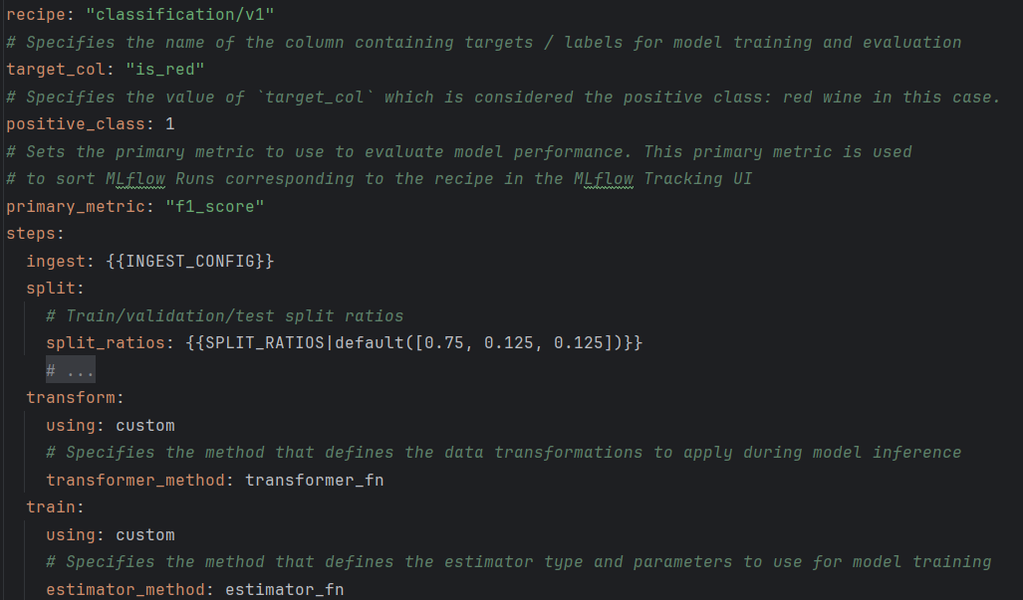
Recipe.yaml
Recipe: Specifica il tipo come "classification/v1".
target_col: Il nome della colonna che contiene i target/label, in questo caso "is_red".
positive_class: Il valore "1" considera la classe positiva.
primary_metric: L'F1-score ("f1_score") è utilizzato come metrica primaria per valutare la performance del modello.
steps: Comprende diverse fasi del flusso, tra cui:
ingest: Richiama un'ulteriore configurazione di input ({{INGEST_CONFIG}}).
split: Definisce i rapporti di suddivisione per train/validation/test (di default: 75%, 12.5%, 12.5%).
transform: Utilizza un metodo personalizzato definito da transformer_fn.
train: Specifica un metodo personalizzato per la formazione del modello definito da estimator_fn.
Notes:
Christian

Slide 74
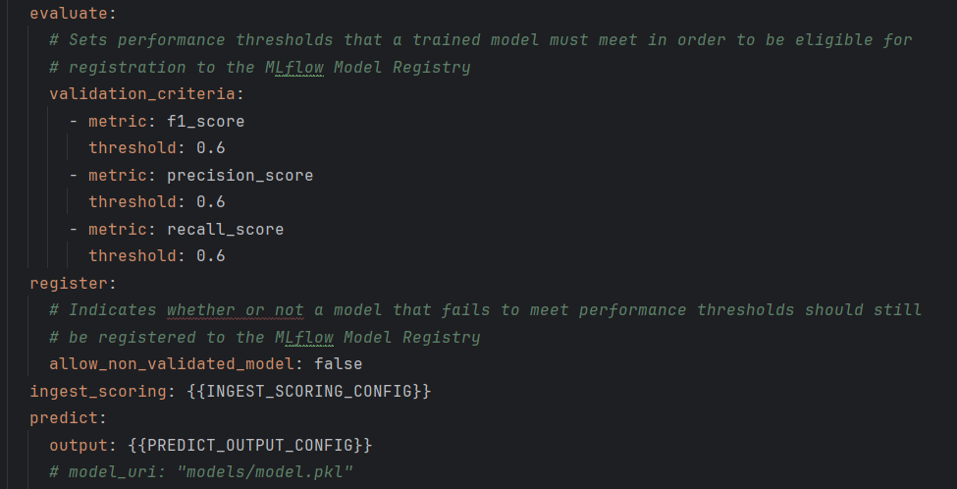
Recipe.yaml
evaluate:
validation_criteria: Specifica le soglie delle metriche che il modello addestrato deve soddisfare per essere idoneo alla registrazione nel MLflow Model Registry. Le soglie indicate sono:
f1_score: ≥ 0.6
precision_score: ≥ 0.6
recall_score: ≥ 0.6
register:
allow_non_validated_model: Impostato su false, indica che i modelli che non soddisfano i criteri di validazione non verranno registrati nel Model Registry.
ingest_scoring: Utilizza una configurazione specifica ({{INGEST_SCORING_CONFIG}}) per l'ingestione durante il processo di registrazione.
predict:
output: Specifica una configurazione per l'output della predizione ({{PREDICT_OUTPUT_CONFIG}}).
Notes:
Christian

Slide 75

Jinja è un motore di template veloce, espressivo ed estensibile. I segnaposto speciali nel template consentono di scrivere codice simile alla sintassi Python. Successivamente, il template viene passato con i dati per generare il documento finale.
Include le seguenti funzionalità:
Ereditarietà e inclusione dei template: Permette di creare gerarchie di template per riutilizzarne parti.
Definire e importare macro all'interno dei template: Consente di creare funzioni riutilizzabili nei template.
I template HTML possono utilizzare l'autoescaping per prevenire vulnerabilità XSS (Cross-Site Scripting) causate da input utente non sicuri.
Un ambiente sandboxed può rendere sicuri i template non affidabili.
Supporto asincrono per generare template che gestiscono automaticamente funzioni sincrone e asincrone senza necessità di sintassi aggiuntiva.
I template vengono compilati in codice Python ottimizzato al momento (just-in-time) e memorizzati nella cache, oppure possono essere precompilati.
Le eccezioni indicano la riga corretta nei template, facilitando il debug.
Supporto a filtri, test, funzioni e persino sintassi estensibile.
Notes:
Marco

Slide 76
Attributi sovrascrivibili con valore predefinito:
Nel file recipe.yaml, si possono definire attributi con valori predefiniti utilizzando la sintassi Jinja2.
Un profilo può sovrascrivere questi valori utilizzando una sintassi a dizionario YAML.
Gli override possono avere tipi arbitrariamente annidati (ad esempio, liste, dizionari, liste di dizionari, ecc.).
Esempio:
In recipe.yaml: threshold: {{RMSE_THRESHOLD|default(10)}} (valore predefinito di 10).
In prod.yaml: RMSE_THRESHOLD: 5.2 (valore sovrascritto per produzione).
Sostituzioni obbligatorie (senza valore predefinito):
Se un attributo Jinja2 non ha un valore predefinito, è obbligatorio specificarlo in un profilo.
I valori possono essere annidati come sopra.
Esempio:
In recipe.yaml: ingest: {{INGEST_CONFIG}} (valore non definito).
In dev.yaml: INGEST_CONFIG: {location: "./data/taxi-small.parquet", format: "parquet"} (valore fornito per sviluppo).
Notes:
Marco

Slide 77
Aggiunte opzionali:
Se un attributo non è definito in recipe.yaml, un profilo può aggiungerlo.
Utile per fornire configurazioni opzionali che la recipe ignora se non specificate.
Esempio: (In local.yaml)
experiment:
tracking_uri: "sqlite:///metadata/mlflow/mlruns.db"
name: "sklearn_regression_experiment"
artifact_location: "./metadata/mlflow/mlartifacts"
Notes:
Marco

Slide 78
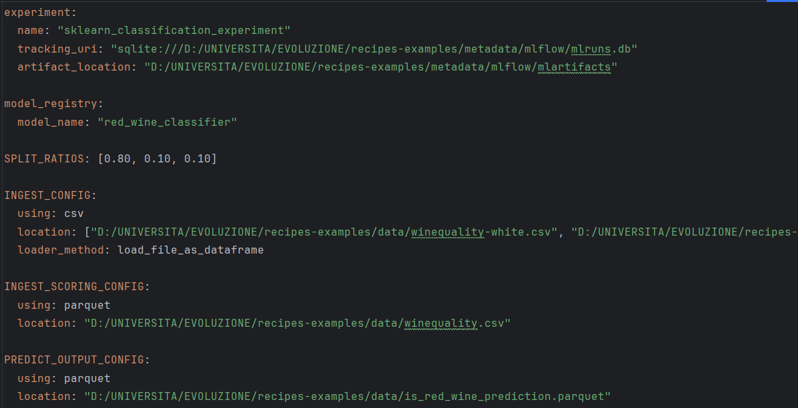
local.yaml
Esperimento MLflow:
Nome: "sklearn_classification_experiment".
URI di tracking: Utilizza un database SQLite locale per gestire i run di MLflow.
Posizione degli artifact: Specificata per memorizzare i risultati del modello.
Model Registry:
Nome del modello: "red_wine_classifier".
Suddivisione del dataset:
Rapporti di split per train/validation/test: [0.80, 0.10, 0.10].
Configurazione dell'ingestione:
Formato: CSV.
Location: Include due file di dataset relativi alla qualità del vino bianco e rosso.
Metodo di caricamento: Utilizza load_file_as_dataframe.
Scoring:
Formato: Parquet.
Dataset: File relativo alla qualità del vino.
Output della predizione:
Formato: Parquet.
File di output: Dataset con predizioni salvato in is_red_wine_prediction.parquet.
Notes:
Marco

Slide 79
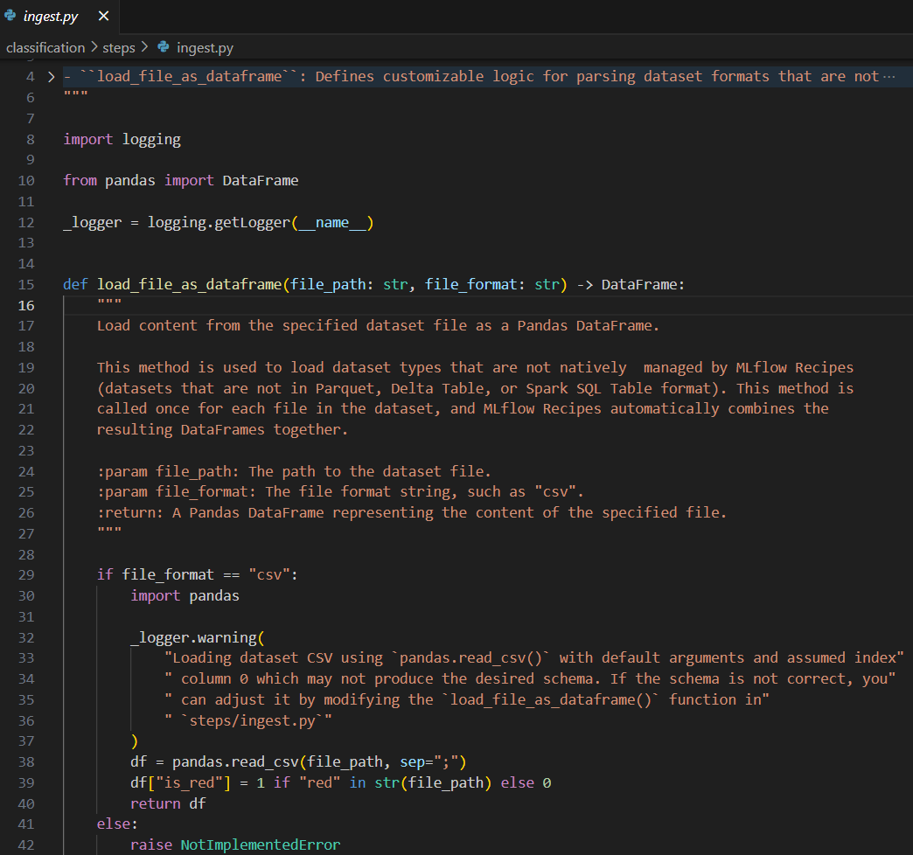
Steps python
Funzione load_file_as_dataframe:
Carica un dataset specificato in un Pandas DataFrame da un file fornito.
Supporta dataset in formati non gestiti nativamente da MLflow Recipes (ad esempio, file CSV).
Riceve due parametri: file_path (percorso del file) e file_format (formato del file, come "csv").
Gestione dei file CSV:
Utilizza la libreria Pandas per leggere i file CSV con un separatore di tipo ,.
Aggiunge una colonna chiamata is_red, impostandola a 1 se "red" è presente nel nome del file, altrimenti a 0.
Fornisce un messaggio di avviso tramite il logger, suggerendo di modificare la funzione se il formato non è corretto.
Estensibilità e fallback:
Se il formato del file non è "csv", la funzione genera un'eccezione di metodo non implementato (NotImplementedError), indicando che il supporto per altri formati deve essere aggiunto manualmente.
Notes:
Marco

Slide 80
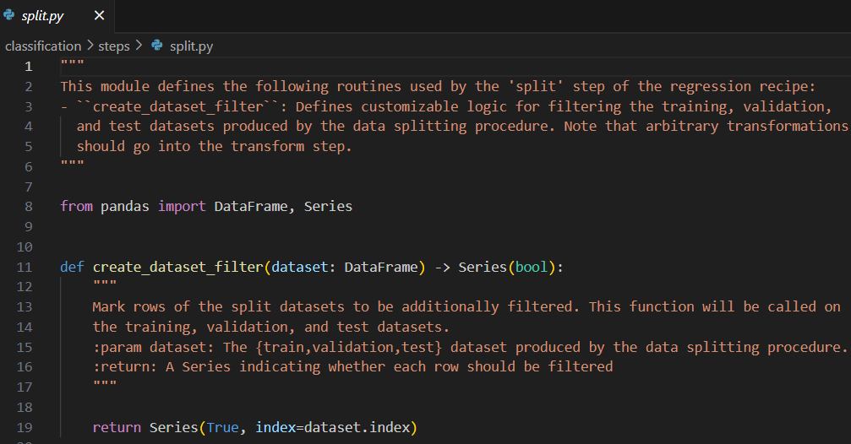
Steps python
Modulo split.py:
Definisce routine per la fase di suddivisione (split) di una ricetta di regressione.
La funzione principale, create_dataset_filter, permette di applicare una logica personalizzata per filtrare i dataset di training, validation e test generati dal processo di suddivisione.
Funzione create_dataset_filter:
Accetta come input un DataFrame (dataset) rappresentante il dataset suddiviso.
Restituisce una Serie booleana che indica, per ogni riga, se deve essere inclusa o filtrata.
Comportamento di default:
Restituisce una Serie in cui tutte le righe del dataset sono marcate come True (cioè incluse) utilizzando l'indice del dataset come riferimento. Può essere personalizzata per filtrare righe specifiche.
Notes:
Marco

Slide 81
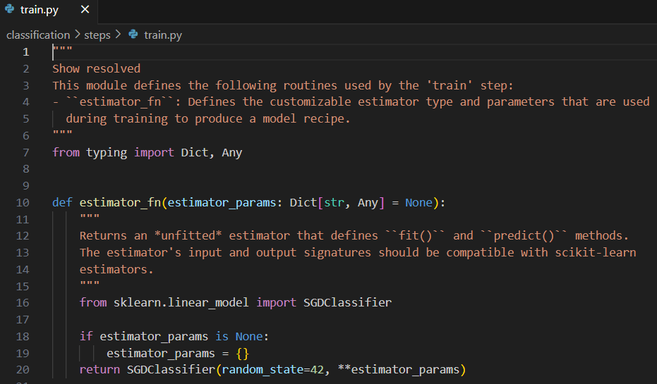
Steps python (cont’d)
Modulo train.py:
Contiene routine per la fase di train di una ricetta MLflow.
La funzione principale, estimator_fn, definisce il tipo di stimatore personalizzabile e i parametri utilizzati durante il training del modello.
Funzione estimator_fn:
Accetta come input un dizionario opzionale di parametri (estimator_params) per configurare lo stimatore.
Restituisce un modello non addestrato (unfitted) compatibile con il framework scikit-learn, che implementa i metodi .fit() e .predict().
Comportamento predefinito:
Se non vengono forniti parametri, utilizza un dizionario vuoto.
Crea un'istanza dello stimatore SGDClassifier di scikit-learn con un random_state=42 e i parametri specificati (se presenti).
Notes:
Marco

Slide 82
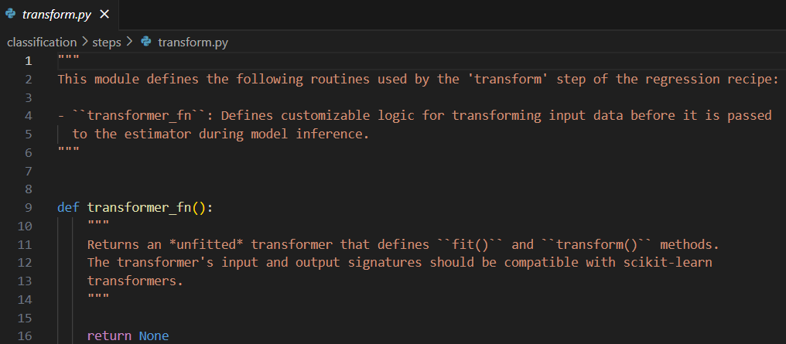
Steps python
Notes:
Marco

Slide 83
Esecuzione
Installazione di make (su ambiente Windows)
mlflow recipes run --profile local
mlflow ui --backend-store-uri sqlite:///metadata/mlflow/mlruns.db --host localhost
Notes:
Marco

Slide 84
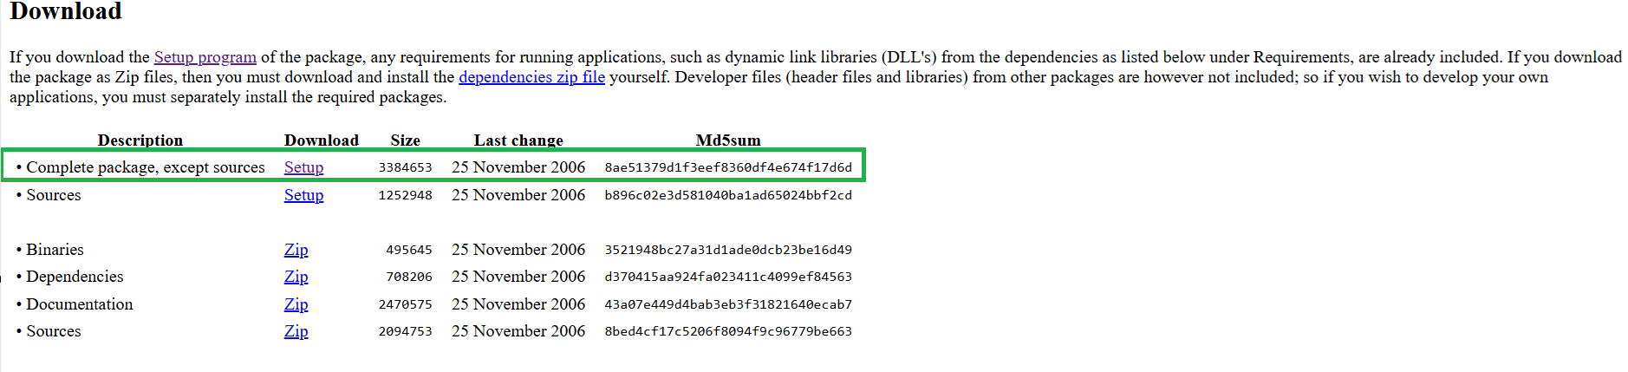
Make
Download:
https://gnuwin32.sourceforge.net/packages/make.htm
Notes:
Marco

Slide 85

Make
Impostare come variabili di ambiente del sistema inserendo:
C:\Program Files (x86)\GnuWin32\bin
Notes:
Marco

Slide 86

Make
Notes:
Marco

Slide 87

Experiments
In MLflow vengono mostrati dettagli sulle esecuzioni recenti, inclusi nomi delle run, durata, sorgenti, e i modelli associati, facilitando la valutazione e la gestione dei risultati degli esperimenti.
Notes:
Christian

Slide 88

Metriche
Confronto tra due esecuzioni del modello, evidenziando il punteggio di accuratezza dei test (test_accuracy_score), con una differenza evidente tra 0.98 e 0.76, e il conteggio degli esempi di test (test_example_count), che rimane costante a 618 per entrambe le esecuzioni.
Notes:
Christian

Slide 89

Registrazione del modello
Notes:
Christian

Slide 90
Metriche di Sistema in Mlflow
MLflow consente agli utenti di registrare metriche di sistema, come l'utilizzo della CPU, GPU, memoria, traffico di rete e utilizzo del disco durante l'esecuzione di un run MLflow. Questa guida spiega come gestire la registrazione delle metriche di sistema con MLflow.
Per registrare metriche di sistema, è necessario installare psutil: pip install psutil
Nota: psutil non è incluso nelle dipendenze di MLflow perché il suo wheel non è disponibile per Linux aarch64 e la compilazione da sorgente può fallire.
Per registrare metriche GPU, è necessario installare pynvml: pip install pynvml
Notes:
Christian

Slide 91
Metriche di Sistema in Mlflow
Abilitare/Disabilitare la Registrazione delle Metriche di Sistema
Ci sono tre modi per attivare o disattivare la registrazione:
Utilizzando una variabile di ambiente:
Imposta MLFLOW_ENABLE_SYSTEM_METRICS_LOGGING su true per abilitare o su false per disabilitare la registrazione globalmente:
export MLFLOW_ENABLE_SYSTEM_METRICS_LOGGING=true
Se sei in un notebook (Jupyter, Databricks, Colab), usa invece:
import os
os.environ["MLFLOW_ENABLE_SYSTEM_METRICS_LOGGING"] = "true"
Notes:
Christian

Slide 92
Metriche di Sistema in Mlflow
Utilizzando le API MLflow:
Per abilitare:
import mlflow
mlflow.enable_system_metrics_logging()
Per disabilitare:
mlflow.disable_system_metrics_logging()
Notes:
Christian

Slide 93
Metriche di Sistema in Mlflow
Per un singolo run:
Imposta log_system_metrics su True o False nel metodo mlflow.start_run():
with mlflow.start_run(log_system_metrics=True) as run:
time.sleep(15)
Notes:
Christian

Slide 94

Tipi di metriche di sistema
MLflow registra di default le seguenti metriche di sistema:
CPU:
cpu_utilization_%
Memoria di Sistema:
system_memory_usage_MB
system_memory_usage_%
GPU (se disponibile e con pynvml installato):
gpu_utilization_%
gpu_memory_usage_MB
gpu_memory_usage_%
gpu_power_usage_watts
gpu_power_usage_%
Rete:
network_receive_MB
network_transmit_MB
Disco:
disk_usage_MB
disk_available_MB
Notes:
Christian

Slide 95


Full Example
Notes:
Christian

Slide 96

Output
Notes:
Christian

Slide 97

Pro e Contro di MLflow
Gestione Completa del Ciclo di Vita del Modello:
Offre strumenti per tracciare esperimenti, gestire modelli, registrare versioni e distribuire modelli in produzione.
Tracciamento Degli Esperimenti:
Registra metriche, parametri, artefatti e tag in modo centralizzato.
Fornisce un'interfaccia web per visualizzare e confrontare i run.
Model Registry:
Facilita il versioning e la gestione di modelli, consentendo un flusso di lavoro chiaro tra sviluppo e produzione.
Indipendenza Dalla Piattaforma:
Supporta diversi ambienti (locale, server centralizzato, cloud come AWS, Azure, Google Cloud).
È integrabile con diversi framework di machine learning (TensorFlow, PyTorch, Scikit-learn, ecc.).
Portabilità dei Modelli:
Consente di salvare e caricare modelli in vari formati (ONNX, PyFunc).
I modelli sono esportabili facilmente per la distribuzione.
Integrazione con Piattaforme CI/CD:
Supporta flussi di lavoro DevOps/MLOps, migliorando la collaborazione tra team.
Semplicità di Implementazione:
Facile da configurare e integrare nei progetti esistenti con poche righe di codice.
Configurazione del Model Registry:
La configurazione del registry richiede risorse aggiuntive, come un database SQL e uno storage per gli artefatti.
Notes:
insieme

Slide 98

Pro e Contro di MLflow
Limitazioni del Tracking Locale:
Utilizzare MLflow solo in locale può diventare complesso con progetti su larga scala (necessità di un server centralizzato).
Dipendenze Esterne:
Alcune funzionalità (come il logging delle metriche GPU) richiedono librerie esterne (es. psutil, pynvml).
Interfaccia Utente non smart:
Sebbene utile, l'interfaccia web non è sempre intuitiva per confrontare grandi quantità di run o gestire modelli complessi.
Limitazioni di Scalabilità Nativa:
In ambienti con elevato numero di utenti o grandi volumi di dati, possono emergere problemi di prestazioni senza un'adeguata infrastruttura.
Supporto GPU Non Automatico:
Il logging delle metriche GPU richiede configurazioni specifiche e non è abilitato di default.
Dipendenza da Python:
Pur supportando diversi framework, MLflow è strettamente legato all'ecosistema Python, il che potrebbe limitare l'integrazione con linguaggi meno comuni nel ML.
Notes:
insieme

Slide 99

Domande?
Notes:
insieme

Slide 100
Recap + Take-home
MLOps enables continuous delivery and deployment of ML models into production in a reliable and efficient way.
MLOps compasses a set of practices, processes, and technology capabilities.
We discussed MLOps Lifecyle and architecture.

Slide 101
An Extra Resource
Machine Learning in Production: From Models to Products
https://ckaestne.medium.com/machine-learning-in-production-book-overview-63be62393581
A book (online) based on a course, "Machine Learning in Production," at Carnegie Mellon University.

